Slide 1

Traffic Volume Study Of ECB CHATTER TO KALSHI
Presented by
Md.Tarifur Rahman (CE2102023131)
Md. Juel Islam (CE2102023120)
Md. Younus Hoque (CE2102023173)
Md. Zahurul Islam (CE2101022105)
Md. Sohel (CE 21002023176)
Supervised by
Monirul Islam.
Lecturer
Department of Civil Engineering
Sonargaon University (SU)

Slide 2
Introduction and Background
A Traffic volume study consists of a Comprehensive investigation of existing physical and operating conditions.
Traffic volume studies are conducted to determine the number, movements and classifications of roadway vehicles at a given location.
Background of traffic volume study:
Traffic Volume studies are used in the planning, design, and operation of roads.
They are used to establish priorities and schedules for traffic improvement.
Traffic volume studies can be conducted manually or automatically.

Slide 3
Research Objectives
Objective of the study:
To Measure traffic Volume and not other related characteristic
(e.g. Flow composition, flow fluctuations etc. )
To compare the result with standard design service volume and identified remedies.
To determine hourly volume in terms passenger car equivalent (PCE) to determine vehicle composition in traffic stream.

Slide 4
Literature Review:
The traffic volume count study is carried out to get following use full information :
Magnitudes , classifications and the time and directional split of vehicular flows.
Proportions of vehicles in traffic stream, proportion of vehicles indicates whether public or private transport dominates the traffic system.
Hourly daily, yearly and seasonal variation of vehicular flows.
Flow fluctuation on different approaches at a junction or different parts of a road network system.
To define Traffic volume study are parameter to be introduced :
Volume flow.
Rate of flow.
Average Daily traffic (ADT).
Average Annual Daily traffic (AADT).
Design hourly volume.
Expansion factor.

Slide 5
Literature Review
(1) Arkatkar (2011) studied the effect of variation of traffic volume, road width, magnitude of and its length on PCU value; by using traffic-flow simulation model HETEROSIM. Field data collected on traffic flow characteristics are used in calibration and validation of the simulation model. The validated simulation model is then used to derive PCU values for different types of vehicles and it indicate that the model is capable of replicating the heterogeneous traffic flow on mid-block sections of intercity roads, for different roadway conditions, to a satisfactory extent.
(2).Satya Narayana (2012) studied the effect of traffic volume, its composition and stream speed on passenger car equivalents. Method proposed by Chandra is used for developing the PCU factors
and found that For two axle trucks PCU values are found to increase with an increase in compositional share of respective vehicle types in the traffic stream. The PCU of two wheelers practically remains unaffected by its compositional share in the traffic stream. Compositional share of 2W at different locations were observed in the range of 31.69% to 34.23% whereas in PCU values are 1.1% only and it may be attributed due to high maneuverability. In slow moving traffic PCU values of bullock carts are increasing with the decreasing in the compositional share in the stream.
(3) Basu D, Maitra S.R (2006) studied the effect of traffic volume and its composition on Passenger Car Equivalency (PCE). Taking the stream speed as Measure of Equivalence (MOE), a methodology is demonstrated for the estimation of PCE. The reduction in stream speed caused by marginal increment in traffic volume by a vehicle type is compared with that of caused by an old technology car, which is taken as the reference vehicle for the estimation of PCE. The st reveals that PCE is affected by traffic volume and its composition. For all vehicle types, PCE values are found to increase with an increase in traffic volume.

Slide 6
Methodology:
Contact system based
Automatic counting method
Contact less system based
Traffic volume study
Direct Method
Manual Counting method
Indirect Method

Slide 7
Automatic counting method: in this method, vehicles are counted automatically without any human involvement.
There are two techniques of automatic counting: contact system based : it is based on pneumatic,mechanical,magnetic or piezo-electric method.
Contact less system: it is based on electrical/optical, ultrasound/infrared radar,microwave,CCTV/video image.
Methodology:

Slide 8
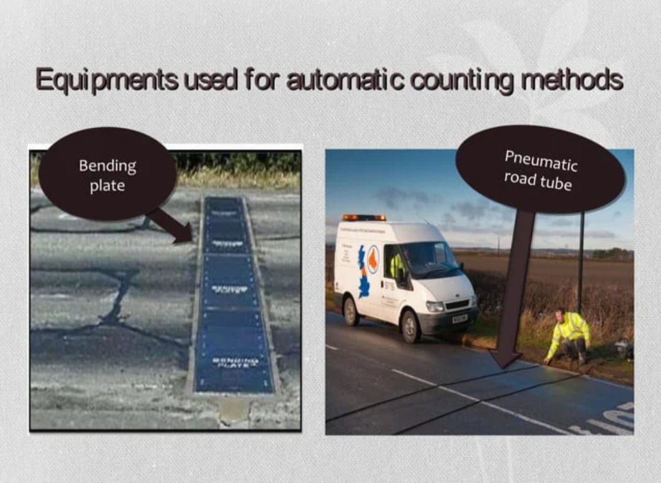
Methodology:

Slide 9
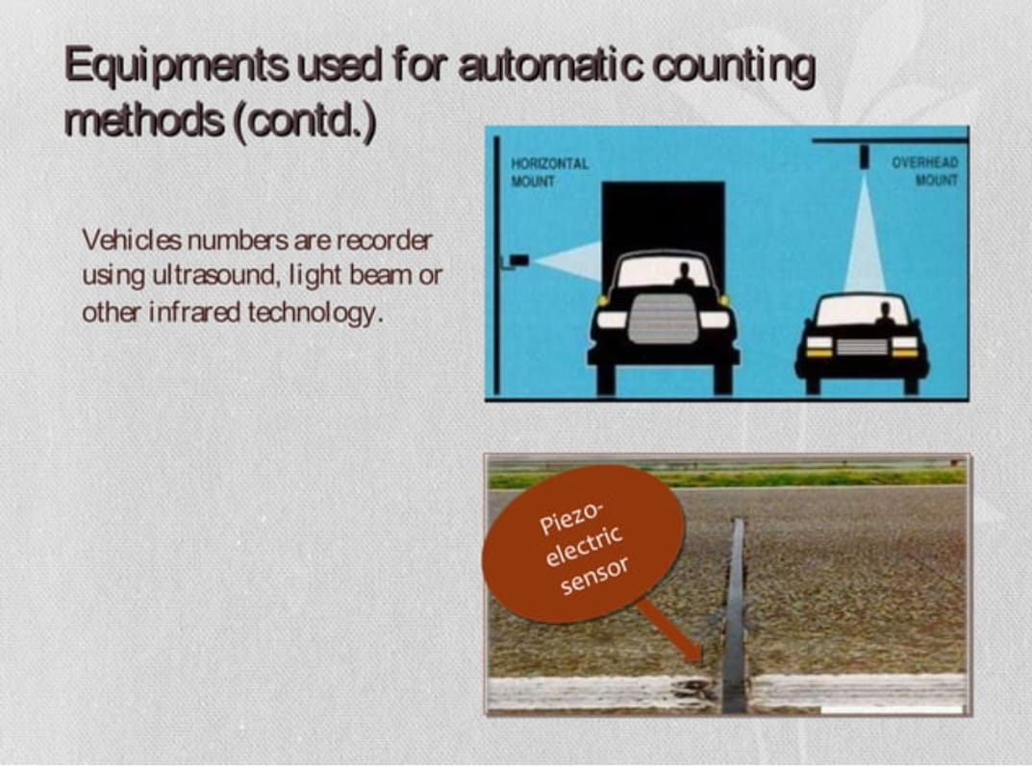
Methodology:

Slide 10
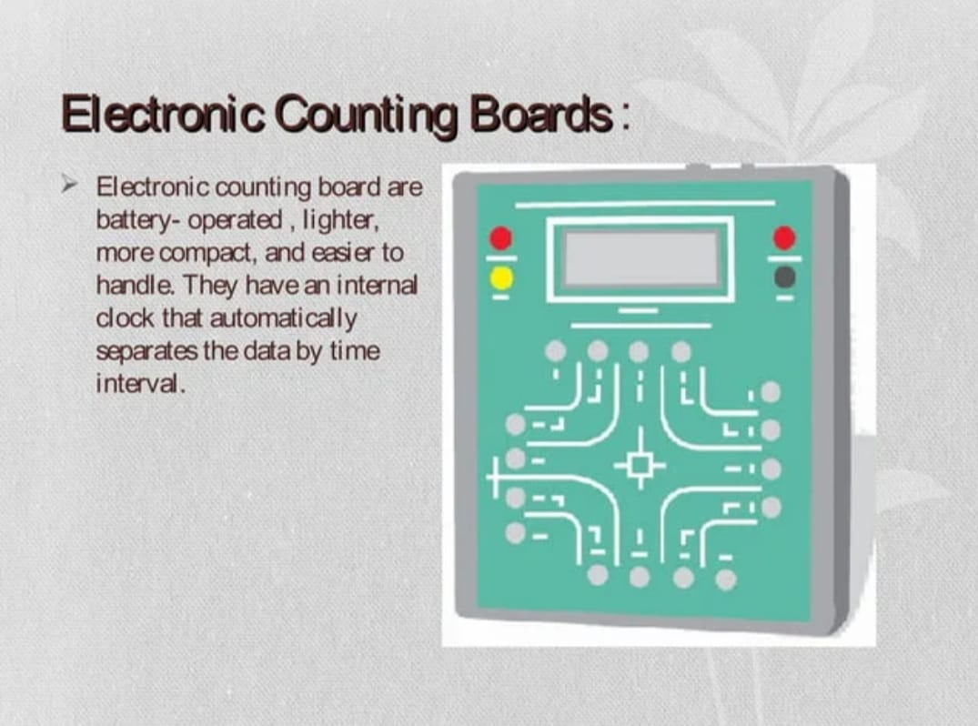
Methodology:

Slide 11
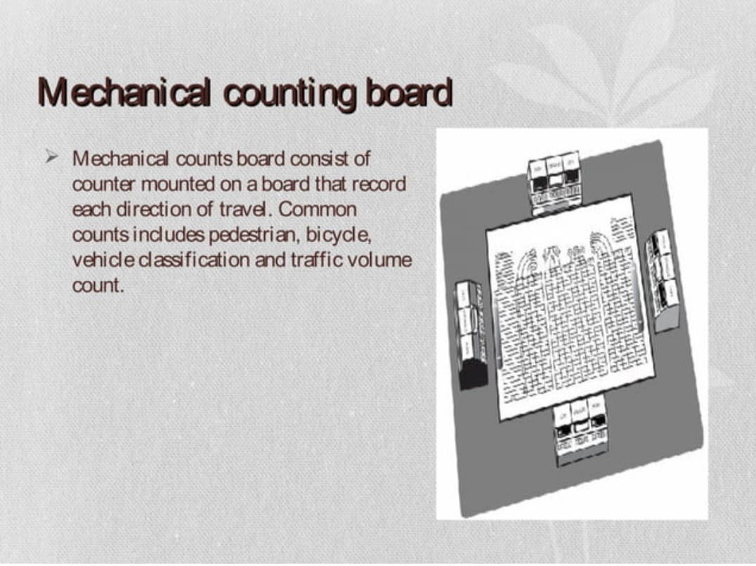
Methodology:

Slide 12
Manual counting method:
There are two types of manual counting :
1.Direct method.
2.Indirect method.
1.Direct method: Data is counted by using hand tally manual counter. Data is recorded by five dash system.
2.Indirect method: in this method ,data is collected using video camera, video is captured for long time and data is collected later.
Methodology:

Slide 13
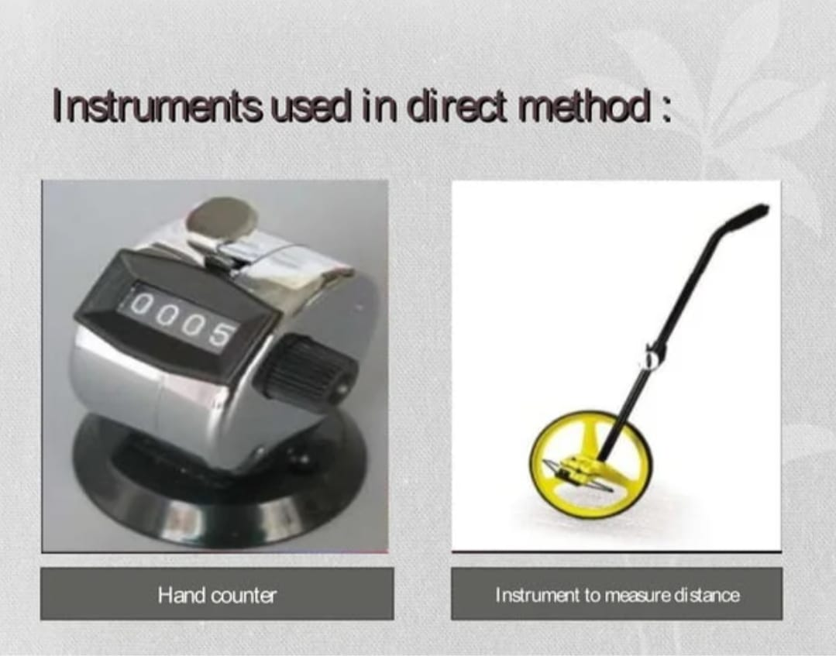

Slide 14
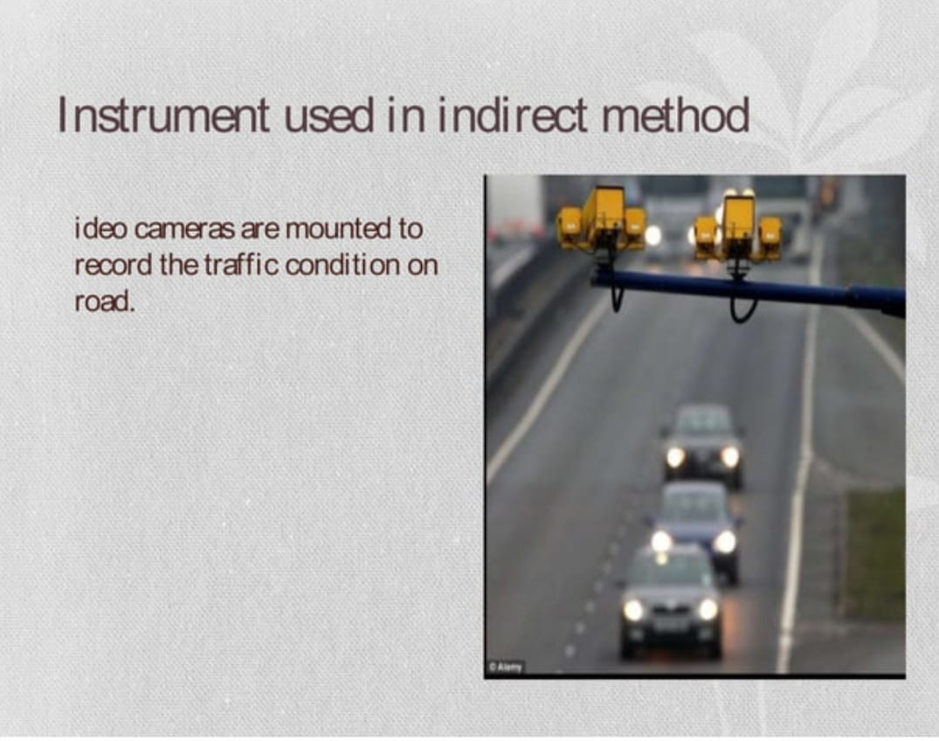
Methodology

Slide 15
Data Collection
Survey Area
Data collected: Ecb to Kalsi Highway Junction .
:Kalsi to Ecb Highway Junction.

Slide 16
Data collection histories:
* Site & Location: ECB to KALSI
*Observation: One directional classified vehicle count.
*Date: 29-.11-2024 TO 03-12-24
* Time: 10.45am – 11.0AM
*Duration: (15) min.
*weather condition: hot and humid day
*Equipment's: stop watch, pencil, eraser, tally sheet(field data sheet),clip board.
Data Collection:

Slide 17
Procedure of work:
Counting Date: Counting from November 29, 2024, To December 3, 2024.
Counting Period:(15) min
Time schedule: Starting at 10:45 am and ending at 8:00 pm
Vehicle Types: Bus, Truck, Private Car and CNG and others
Method: Manual Method
Equipment’s : Data Sheet, Stop Watch, Calculator.
Survey Location: ECB Chatter to Kalshi Dhaka Highway intersect.
Data Collection:

Slide 18
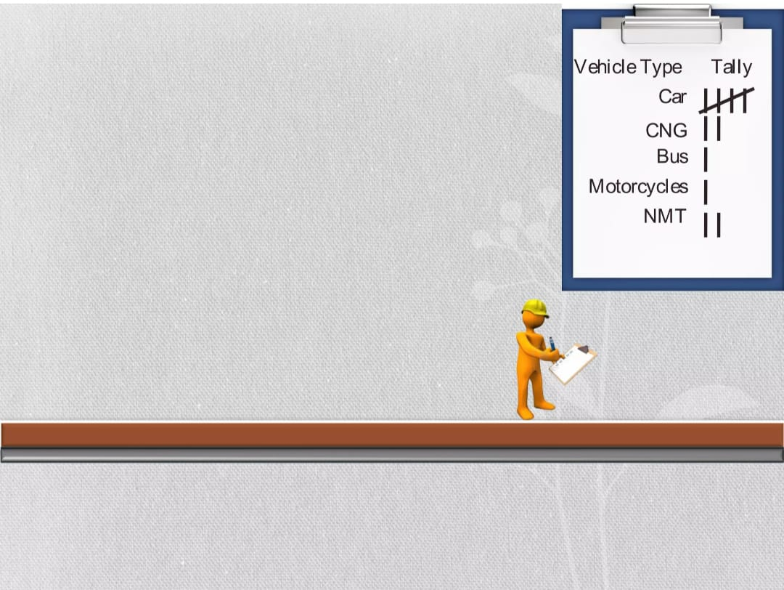

Slide 19
Data Collection
Workdays traffic volume variation (av.) (Sunday-Tuesday)
Time Interval | Bus | Truck | Private Car | CNG/ Rikshaw | Motor cycle | Others/ ambulance | Total
10:45am – 11:00 am | 26 | 23 | 246 | 86 | 176 | 12 | 569
2:45pm – 3:00 pm | 32 | 50 | 203 | 70 | 190 | 15 | 560
7:45 pm – 8:00 pm | 31 | 42 | 210 | 75 | 185 | 10 | 553
Total | 89 | 115 | 659 | 231 | 551 | 37 | 1682

Slide 20
workdays traffic volume chart.
Data Collection
This column chart shown that, on that day highest Bus across at 2.45 pm – 3.00 pm, highest Truck across at 2:45 pm – 3:00 pm, highest Private Car across at 10:45 am – 11:00am, highest CNG across at 10:45 AM – 11:00AM,highest motor cycle across 2.45 pm-3.00 pm and highest others vehicle across 2.45pm-3.00pm.

Slide 21
Workdays traffic volume percentage.
Data Collection.
In that pie chart shown that, there percentage of workdays traffic volume variation . For Workdays
05% Bus, 07% Truck, 39% Private Car,14% CNG,33% Motor Cycle ,33% others 2% Vehicle Across.

Slide 22
Off days traffic volume variation.(av.)
(Friday-Saturday)
Data Collection
Time Interval | Bus | Truck | Private Car | CNG/ Rickshaw | Motor cycle | ambulanc e | Total
Moring session | 43 | 54 | 225 | 58 | 171 | 11 | 562
Afternoon session | 44 | 70 | 201 | 73 | 200 | 11 | 599
Evening session | 40 | 59 | 204 | 65 | 193 | 8 | 569
Total | 127 | 183 | 630 | 196 | 564 | 30 | 1730
This column chart shown that, on that day highest Bus across at 2.45 pm – 3.00 pm, highest Truck across at 2:45 pm – 3:00 pm, highest Private Car across at 10:45 am – 11:00am, highest CNG across at 02:45 PM –03:00PM, highest motor cycle across 2.45 pm-3.00 pm and highest others vehicle across 2.45pm-3.00pm.

Slide 23
Off-days traffic volume percentage.
Data Collection.
In that pie chart shown that, there percentage of workdays traffic volume variation . For Workdays 05% Bus, 07% Truck, 39% Private Car,14% CNG,33% Motor Cycle ,33% others 2% Vehicle Across.

Slide 24
PCU Value work days.
Results and findings :
TIME INTERVAL | BUS | PCU RATE | PCU PC/HR | TRACK | PCU RATE | PCU PC/HR | PRIVATE CAR | PCU RATE | PCU PC/HR | TOTAL PCU/HR
MORNING SESSION | 72 | 3 | 216 | 88 | 3 | 264 | 317 | 1 | 317
AFTERNOON SESSION | 67 | 3 | 201 | 89 | 3 | 267 | 306 | 1 | 306
NIGHT SESSION | 58 | 3 | 174 | 81 | 3 | 243 | 317 | 1 | 317
TOTAL |  |  | 591 |  |  | 774 |  |  | 940
TIME INTERVAL | CNG | PCU RATE | PCU PC/HR | MOTOR CYCLE | PCU RATE | PCU PC/HR | Others | PCU RATE | PCU PC/HR | TOTAL PCU/HR
MORNING SESSION | 82 | 0.75 | 61.5 | 210 | .75 | 157.5 | 7 | 1 | 7 | 1023
AFTERNOON SESSION | 83 | .75 | 62.25 | 193 | .75 | 144.75 | 7 | 1 | 7 | 988
NIGHT SESSION | 82 | .75 | 61.5 | 209 | .75 | 156.75 | 9 | 1 | 9 | 961.25
TOTAL |  |  | 185.25 |  |  | 459 |  |  | 23 | 2972.25

Slide 25

Calculation:
Hourly, Daily and monthly Expansion Factor
Hourly = 22.05
Daly =7.012
Monthly = 1.756
For duration rate service
Duration Time=15 min.
60 min = 2972x$\frac{60}{15}=11888 vph$
1. Daily volume =11888 X 22.05=262130 vpd
2.Weekly Volume =262130x 7.012=1838058 vpw
3. ADT =262579 vpd
4. AADT = ADT X MEF
=262679 X 1.756 vpd =461090 Vehicle.

Slide 26
WORK DAYS PCU CHART.
Data collection:
. For this column chart shown that, PCU in works days by 3 sessions. Highest PCU rate for workdays was morning Session, which PCU value 1023 pc/hr. Secondly, afternoon Session PCU value 985 pc/hr. Thirdly and the lowest PCU value found 962 pc/hr.

Slide 27
PCU Percentage in Different Vehicle Class (Workdays)
In that pie chart shown that, there percentage of PCU (pc/hr.).
For Workdays
20% Bus,
26% Truck,
32% Private Car,
6% CNG,
15% Motor Cycle ,
1% others across
ECB to Kalshi

Slide 28
Conclusion:
percentage of public transport is very low. Based on our Result, we obtained that the private car are the majority of the vehicle at the area. The second most road users will be the truck follow the pedal, Moreover, long period hours of observations should be performing in order to have a batter understanding of the traffic volume at the junction. In conclusion, our objective of the study are achieved.

Slide 29
Limitations and recommendation:
Short count was taken (15min).
Now a day’s automatic counting method based on CCTV/Video image processing is reliable and popular. But due to resource constraint it was not possible.
Manual Count Method requires trained enumerators which was unavailable in this particular case.
NMV should not be allowed.
Amount of public transport should be increased.
To increase the LOS necessary steps should be taken to prevent the entrance of NMV, stop roadside parking, prevent pedestrian crossing, and introduce optimum traffic signal system.
Construct foot over bridges at necessary point for pedestrian crossing
Driver’s selection of speed and reduced ability to pass is reduced. The volume count must contain more than one cycle to get more authentic value.

Slide 30
Scope for future study:
DESIGN
PLANNING
IMPROVEMENT
DYNAMIC TRAFFIC MANAGEMENT SYSTEM
ESTIMATING HIGH WAY USE
COMPUTING ACCIDENT RATES
TRAFFIC STREAM

Slide 31
References:
(1).Arkatkar, S. S. (2011). Effect of intercity road geometry on capacity under heterogeneous traffic conditions using microscopic simulation technique. International Journal of Earth Sciences and Engineering, 4(6), 375-380
(2).Satya Narayana, P. V. H., Druga, K., & Raju, S. G. (2012). Development of PCU factors and capacity norms at mid blocks of rural highways in Visakhapatnam. Indian Journal of Education and Information Management, 1(5), 197-202.
(3).Basu, D., Marita, S.R. and Marita, B. (2006), “Modelling passenger car equivalency at an urban midblock using stream speed as measure of equivalence”, International Journal of Transport Economics, Engineering and Law, European Transport.

Slide 32
Thank you.

