Slide 1

PERFORMANCE ANALYSIS OF A HOUSEHOLD VAPOR
COMPRESSION REFRIGERATION CYCLE
A thesis submitted to the Department of Mechanical Engineering, Sonargaon University, Dhaka, on May 2024 in partial fulfilment of the requirements for The degree of B.Sc in Mechanical Engineering.

Slide 2
PERFORMANCE ANALYSIS OF A HOUSEHOLD VAPOR
COMPRESSION REFRIGERATION CYCLE
SUBMITTED BY
Md Jewel Alamin ID:ME2003022289
Md. Kawsher ID:ME2003022092
Md Jobyer Ahammed ID:ME2003022045
Rasel Ahamed Emon ID:ME2003022093
Shuvojit Ghosh. ID:ME2003022178
SUPERVISED BY
Abrar Sobhan Chowdhury
Lecturer
Department of Mechanical Engineering
Sonargaon University

Slide 3
Thesis presentation outline
Introduction 4-5
Problem statement 6
Objective of research 7
Literature review 8
Design and component 9-12
Experimental procedure 13-15
Data collection & Calculation 16-20
Results and Discussion 21-26
Recommendation 27-28
Conclusion 29

Slide 4
Introduction
• Refrigeration is the process in which heat is removed from a enclosed space at a temperature lower than its surrounding temperature. This is done by continuous extraction of heat from the enclosed space whereas the temperature
is below than that of the surrounding temperature by Using Refrigerant
• Now a days refrigeration place a big part in our everyday life industrially and domestically
• In domestic refrigeration system different type of refrigeration system is used but vapor compression refrigeration system is the most commonly used
• There are some major components of vapor compression system which are
1. Compressor 2. Condenser 3. Expansion valve 4. Evaporator

Slide 5
Compression: The refrigerant gas is compressed by the compressor, increasing its pressure and temperature.
Condensation: The hot, high-pressure refrigerant gas flows into the condenser coils, where it releases heat to the surroundings and condenses into a liquid.
Expansion: The high-pressure liquid refrigerant passes through an expansion valve or capillary tube, where its pressure and temperature drop significantly.
Evaporation: The low-pressure liquid refrigerant enters the evaporator coils, where it absorbs heat from the surrounding area (e.g., inside a refrigerator or room), causing it to evapor

Slide 6
Problem Statement
•Now-a-days, refrigeration system is important because it is widely used for domestic application. However, the actual performance of the refrigerator is still unknown. So, we need some research to analyze the actual performance of refrigerator.
•At the same time, we need to analyze the coefficient of performance under usual condition and power. For this we have to a household refrigerator to find the coefficient of performance.

Slide 7
Objectives of Research
•To analyses the performance of the refrigeration system.
•To learn and understand the basic vapor compression refrigeration systems.
•To identify correctly the exact locations of points where the data for
temperature and pressure should be collected.
•To improve the •configuration of the refrigerator to a simpler form based on previous
development and research on basic vapor compression cycle.
•To identify the scope to improvise the cycle performance for the future.

Slide 8
Literature review
• Historical Evolution: Reviewing the development of refrigeration technology from its early beginnings to modern systems, highlighting key milestones, breakthroughs, and notable contributors.
• Technological Advancements: Examining recent innovations in refrigeration system design, components, and materials. This could include advancements in compressor technology, heat exchangers, control systems, and refrigerants.
• Performance Optimization: Discussing methods for improving the efficiency, reliability, and performance of refrigeration systems. This could involve optimizing system design, enhancing heat transfer processes, implementing energy-saving techniques, and integrating renewable energy sources.
• Environmental Impact: Assessing the environmental impact of refrigeration systems, particularly in terms of greenhouse gas emissions, ozone depletion, and energy consumption. This could involve reviewing the phase-out of ozone-depleting substances such as CFCs and HCFCs, as well as the transition to low-GWP (Global Warming Potential) refrigerants and the adoption of environmentally friendly technologies such as magnetic refrigeration and thermoelectric cooling.

Slide 9
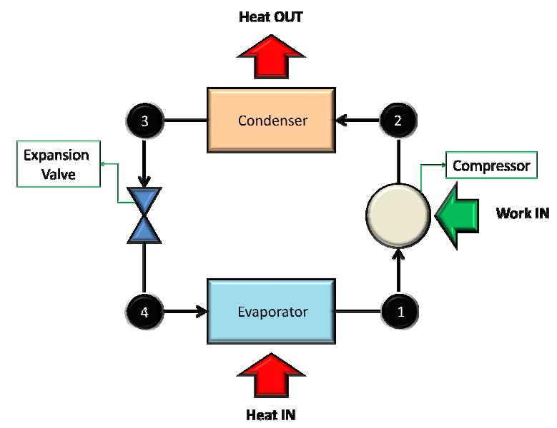
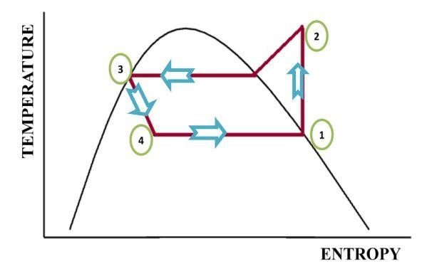
Design and Components
• Design : A vapor refrigeration cycle is composed of several components. The main components are evaporator, compressor, condenser and capillary tube. The refrigerant has gone through three phases in this VCRC. In figure red, green and yellow shows three phases of refrigerant which are vapor, liquid and liquid-vapor respectively. In our design we have used four digital temperature meters for measuring temperature of delivery line, condenser, evaporator and surrounding. To measure the pressure of delivery line we have used high pressure gauge .Besides to measure the pressure of suction line we have used low pressure gauge.

Slide 10
Referring to Figure 3.2, the functions of the four main components of an ideal VCRC may be summarized as follows:
1-2 Compressors: The low pressure saturated vapor is compressed to a high pressure superheated vapor under constant entropy value.
2-3 Condensers: The high pressure superheated vapor is sub-cooled to s saturated vapor state and then condenses into a saturated liquid state under constant pressure.
3 -4 Capillary Tubes: The high-pressure saturated liquid is expanded to a low pressure and temperature liquid-vapor mixture at constant enthalpy.
4-1 Evaporator: The low-pressure two-phase mixture boils to saturated vapor under constant pressure.
Components

Slide 11
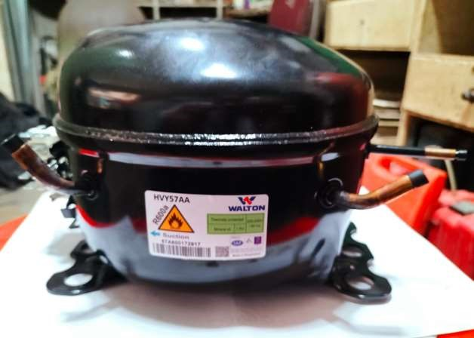
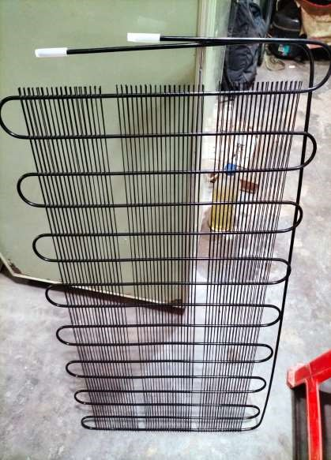
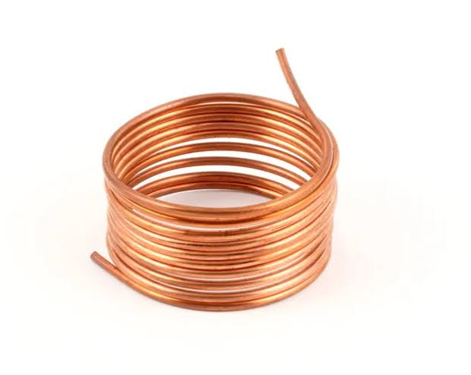

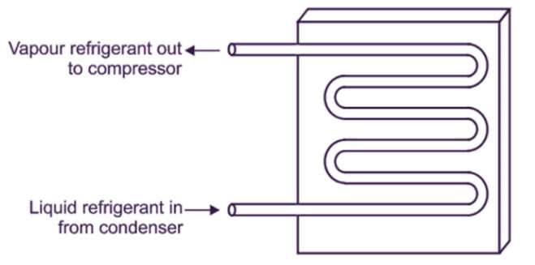
Components
Compressor
Expansion
Devices
Condenser
Evaporator

Slide 12
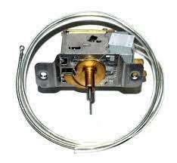
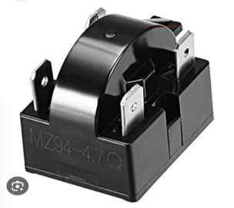
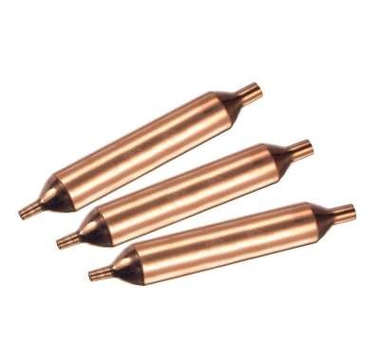
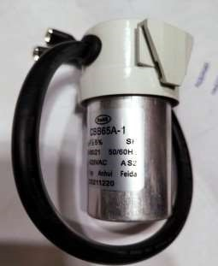
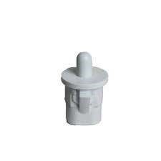
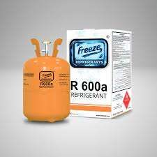
Thermostat
Over load Relay
Strainer
Capacitor
Door Switch
Gas

Slide 13
Experimental Procedure
• When the experimental setup was ready and inspected visually then we turned the power supply on and let the system reach a stable condition
•We started of by taking the wall temperature of fridge and freezer with 3 different digital temperature thermometer
•Then we have put 4 different size (250ml,500ml,1L2L) of bottles in fridge and freezer also
•When putting the bottles inside the fridge and freezer we also Attached 1 temperature thermometer with each of the bottles
•Then we made data table and graphs according to those temperature readings

Slide 14
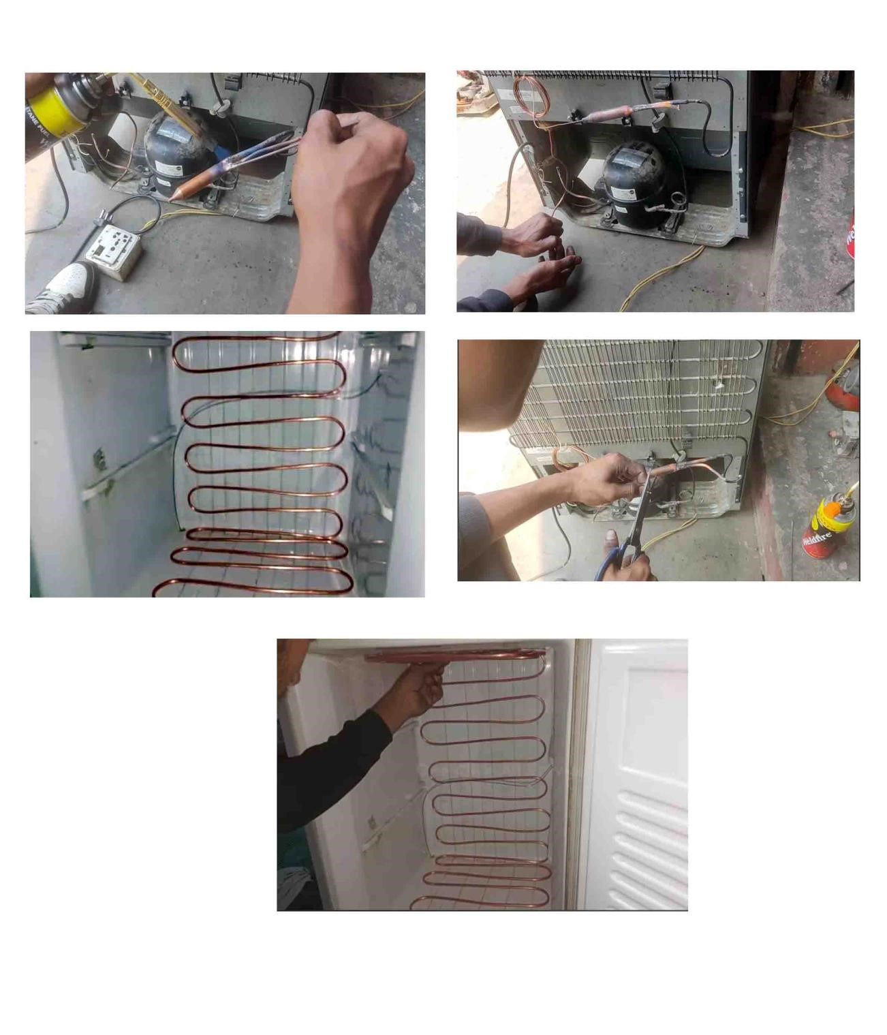
Some Snapshots of Test Rig during Construction

Slide 15
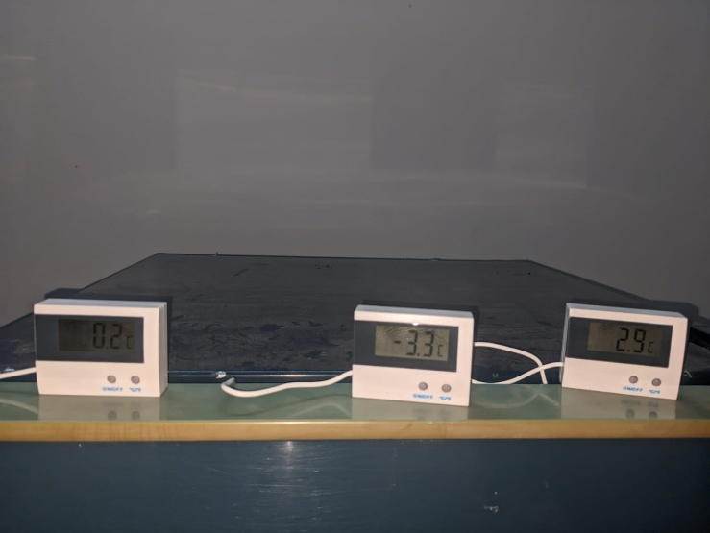
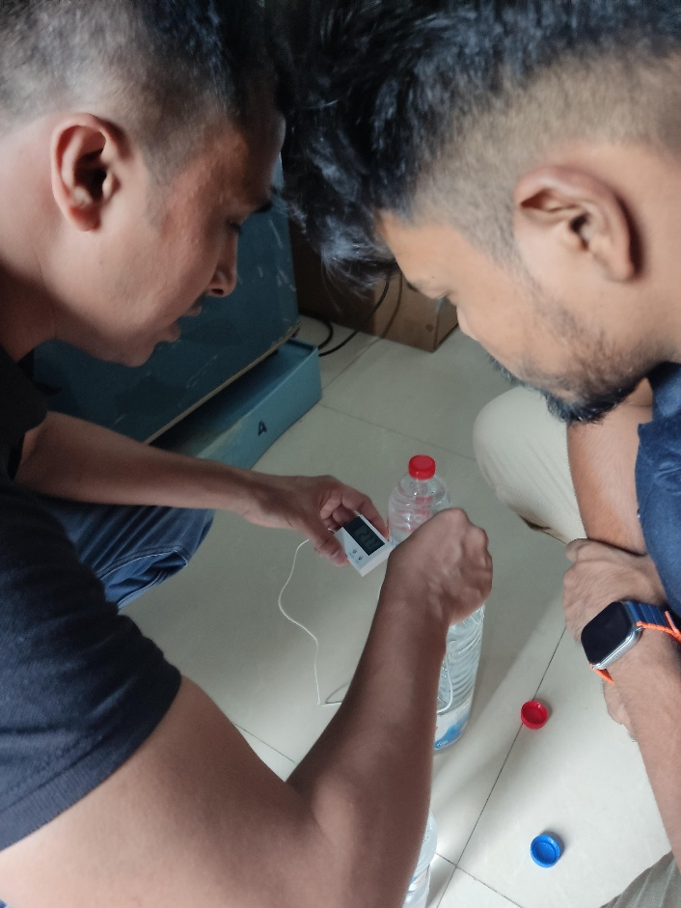

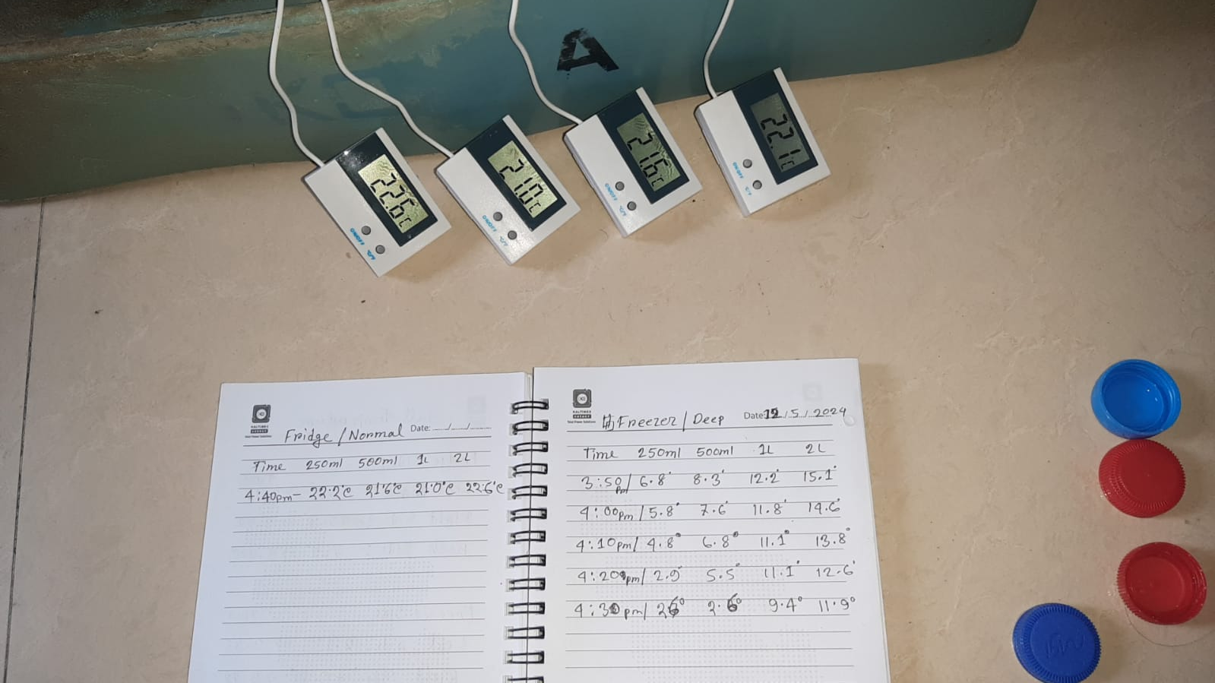

Slide 16
Data Collection
We have taken data from different type of bottles (250ml,500ml,1L,2L) for 2 days so that we could compare the data of different type of bottles. Refrigeration system would depend more on the refrigeration unit’s specifications (such as compressor efficiency, refrigerant type, etc.) rather than the size of the bottles being refrigerated. However, larger bottles may require more energy to cool down and maintain their temperature compared to smaller ones, potentially affecting the overall efficiency of the refrigeration system. So we noted down the data as the temperature changes over time of the different type of bottles and The side walls of the fridge and freezer compartment. Finally the performance analysis is conducted using mathematical analysis.

Slide 17
Table 4.1:Experimental Data Of R600a
TimeRe adingTa ken | Compress- orinletPress ure P₁(MPa) | CompressoroutletPress ureP₃(MPa) | Compressorinl et T₁˚C | Temp | Compressor outletTemp T₂˚C | Condenser inlet Temp T₃ ˚C | Condenserout letTempT₄˚C | Evaporator Tempature
10:30 | 0.9738 | 0.2206 | 29.9 |  | 39.7 | 34.1 | 30.4 | 10
10:45 | 0.8618 | 0.1013 | 30.1 |  | 50.4 | 40.6 | 30 | -13.7
11:00 | 0.82773 | 0.0851 | 28.8 |  | 55.8 | 45.6 | 31.5 | -16.3
11:15 | 0.8066 | 0.0724 | 27.5 |  | 58.9 | 46.8 | 29 | -20.2
11:30 | 0.7928 | 0.0668 | 27 |  | 60.1 | 49.6 | 27.9 | -23.4
11:45 | 0.7584 | 0.0584 | 26.9 |  | 63.7 | 51.4 | 26.9 | -25.1
12:00 | 0.7574 | 0.0574 | 26 |  | 66.9 | 52.8 | 28.6 | -26
12:15 | 0.7574 | 0.0574 | 25.5 |  | 70.1 | 54.9 | 28 | -26
12:30 | 0.7574 | 0.0574 | 26 |  | 71 | 56.8 | 27.9 | -26

Slide 18
Table 4.2(a): Temperature Of Wall’s in Refrigerator & Freezer (Day 1)
Temperature Of Wall's in Refrigerator & Freezer (Day 1)
Types Of Bottles | left side | right side | Back side
Refrigerator | 21 | 22 | 5
Freezer | -4 | -1 | -5
Table 4.2(b): Temperature Of Wall’s in Refrigerator & Freezer (Day 2)
Temperature Of Wall's in Refrigerator & Freezer (Day 2)
Types Of Bottles | left side | right side | Back side
Refrigerator | 20.8 | 20.6 | 3.6
Freezer | -7.9 | -4.2 | -9.4

Slide 19
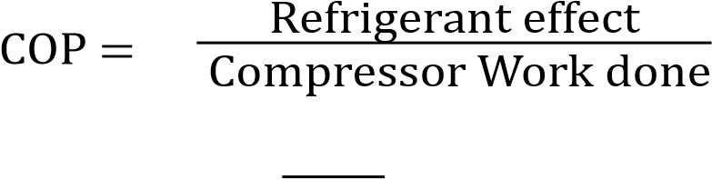
4.4 Calculation:
In order to find the performance and COP of the refrigerator, we use the following steps to calculate the compressor work, refrigerating effect, mass flow rate and volumetric efficiency. The enthalpy values are taken from the P-h diagram of R600a refrigerant.
1 Compressor Work done (w)=(h2–h1)KJ/Kg
2 Refrigerant effect Per Kg(RE)=(h1–h3)KJ/Kg
Where, h1 =Specific Enthalpy at the inlet of compressor
(KJ/Kg)h2=Specific Enthalpy at the outlet of compressor
(KJ/Kg) h3 =Specific Enthalpy at the outlet of
condenser (KJ/Kg)h4=Specific Enthalpy at the inlet of evaporator(KJ/Kg)
3.

Slide 20
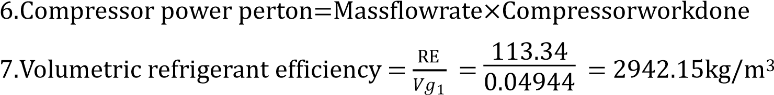
3.517
RE
________
4. Mass flow rate =
5. Compression ratio =
Discharge Pressure
Suction Pressure

Slide 21
RESULTS AND DISCUSSION’S
The experimental analysis caused the following data table for the calculation of the results based on the collected data. All parameters were calculated from the experiments and finally the performance of the refrigerator was investigated. It was found that the COP of the refrigerator is 1.92 and the refrigerating effect was 170 KJ/kg while the compressor work is around 100 KJ/kg. The table 5.1 provides the calculated results taken over a time period of 2 hours with 15 minutes interval.
Time | Refrigerant- effect per kg(KJ/Kg) | Compressor work done(KJ/ Kg) | Compressor Power per ton(kW) | Compress orratio | COP | Volumetric coolingcapacity (kg/m³⁾
10:30 | 205.49 | 71.94 | 1.2229 | 4.41 | 2.85 | 1205.64
10:45 | 187.94 | 96.93 | 1.7447 | 8.50 | 1.92 | 531.24
11:00 | 199.01 | 100.15 | 1.7025 | 9.72 | 1.99 | 638.47
11:15 | 186.68 | 102.57 | 1.8392 | 11.12 | 1.82 | 385.15
11:30 | 185.18 | 103.87 | 1.8696 | 12.18 | 1.78 | 353.80
11:45 | 185.01 | 104.01 | 1.8791 | 13.02 | 1.77 | 213.24
12:00 | 185.01 | 104.01 | 1.8791 | 14.18 | 1.77 | 213.24
12:15 | 185.01 | 104.01 | 1.8791 | 14.18 | 1.77 | 213.24
12:30 | 185.01 | 104.01 | 1.8791 | 14.18 | 1.77 | 213.24
12:45 | 185.01 | 104.01 | 1.8791 | 14.18 | 1.77 | 213.24

Slide 22
Now the Average COP of Refrigerator =1.92
• Net mass flowrate =0.018Kg/s
• Net Refrigerant effect=170.26KJ/Kg
Refrigerator capacity in tons = = 0.7880
Mass flow rate x RE x 3600
14000

Slide 23
Compressor outlet
Time Evaporator Temperature
80
15
70
10
60
5
50
0
40
-
5
Taken
10:30
10:45
11:00
11:15
11:30
11:45
12:00
12:15
12:30
30
-
10
20
-
15
10
-
20
0
-
25
Taken
10:30
10:45
11:00
11:15
11:30
11:45
12:00
12:15
12:30
-
30
Compressor outlet
Time
(Compressor Outlet)
(Evaporator Temperature)

Slide 24
In this graph all the different type of bottles started at the same temperature point but went parabolic while inclining
In this graph all the different type of bottles started at the same temperature point but followed almost a straight linear path

Slide 25
In this graph all the different type of bottles started at the same temperature point but went parabolic while inclining
In this graph all the different type of bottles started at different temperature
point but followed linear path but at a point some inclined some stayed straight

Slide 26
It is found that from the experiment, the minimum wall temperature in the refrigerator was around 3.5 degree Celsius at the back wall while the side walls had a temperature of 20 degrees. It was found the water bottles experimented reached almost similar temperature to the side walls within around an hour. This shows that the system performance is satisfactory and efficient. From the figure 5.1 and 5.3, we observe a constant reduction in temperature with time. The graph follows linear pattern for fall of temperature in terms of refrigerator.
In case of the freezer, it was noticed that, the fall of temperature is more significant with time. Since the wall temperatures of the freezer remains below 0 °C, the heat transfer rate in this case is higher. It allows the temperature of the water bottles to reach below the freezing point within a time period of one and a half hours approximately. The pattern followed for the freezer is not linear and inconsistent. Moreover, parabolic pattern is also observed for the freezer segment.
The results also revealed that 250 mL water bottle is cooled faster compared to other specimens and 2L bottle required the maximum time to cool. It is due to the volume difference of the bottles which allows a higher rate of cooling in smaller volume. In the refrigerator, a temperature fall of 8.5 degrees is found whereas in the freezer the temperature difference noticed is more than 20°C for the same experimental period.

Slide 27
RECOMMENDATIONS
•May contain sensor based doors for auto open or close like lift door.
•Brighter and more efficient chamber LED lights can be added.
•Electronic touch controls may be incorporated in the system.
•More efficient chilling technology.
•Out looking can be developed by using proper tools and architectural designs.
•Models with three doors and a freezer on the bottom may be introduced.
•Thinner, more effective insulation.
•Radio devices that make them Internet and smart-grid ready to take advantage of
future improvements in convenience and efficiency.

Slide 28
•Identifying cooling load automatically and serve properly based on that.
•Advanced defrost sensor may be added which minimize frost build-up to maintain evaporator coil efficiency.
•Battery backup can be attached to assure control panel function during power failure.

Slide 29
CONCLUSIONS
This experiment was carried out in order to observe and analyses the performance of simple vapor compression refrigeration cycle in its normal condition. Temperature measurements were taken with special care. The cooling performance was observed by using water bottles of various sizing. The conclusions that could be taken from this experiment are as follows:
Refrigerant R 600a is HFC Free to on Environment friendly refrigerant gas the remove the
global warming to mains component of carbon dioxide (CO2) remove to save the greenhouse
and great high security global warming potential the power less compressor used to save
energy to the energy to regulated the future generation to stock fossil fuel.
Food storage the importance of refrigeration storing food at cold temperature relative humidity
slows are the growth of microorganisms there by limited food poisoning while preserving foods nutritional qualities and good test.
The performance of the refrigerator is satisfactory as temperature reached near wall temperature
in case of the experimented samples.

