Slide 1

SONARGAON UNIVERSITY
Automatic Load and Power Monitoring
Submitted By
Supervised By
Md.Azizul Haque Shakil | ID No: EEE-2102023006
Md. Abu Sayem | ID No: EEE-2102023121
Nazmun Nahar | ID No: EEE-2102023090
Ariful Islam | ID No: EEE-2102023108
MD. Mohatashim billa ferdouse | ID No: EEE-2102023095
Swadesh Vhakta
Lecturer
Department of EEE
Sonargaon University, Bangladesh

Slide 2
Outline
Introduction.
Background.
Objective.
Block Diagram Of Project.
Components.
Circuit Diagram.
Flow Chart.
Project Picture.
Calculation
Result.
Applications.
Future Work.
Conclusion.

Slide 3
Introduction
In today's industrial electricity is an essential energy source. Its intricate, non-linear networks provide operational benefits, financial savings, and accountability. The economy and security are impacted by its failure, making it an essential part of infrastructure. Utility companies and end users would profit from the detection and localization of electrical line constraints made possible by a monitoring system.

Slide 4
Background
The complexity of the distribution network and rising load demand in our country have led to increased power production costs and higher electricity prices. To reduce costs and prevent waste, it is essential to monitor and control our electricity usage. Microcontrollers can dynamically monitor load consumption, alerting the sink or delaying notifications. This increases consumer demand for electricity, thereby increasing the value of electricity supplied to users. Understanding these systems is crucial for improving electricity quality and preventing waste. By implementing these measures, we can contribute to the country's electricity reputation and reduce waste.

Slide 5
Objective
To control and monitor the loads.
To calculate room load automatically.
To develop an Android app for controlling and monitoring loads.
To develop the economy by providing reliable energy to the consumer load.

Slide 6
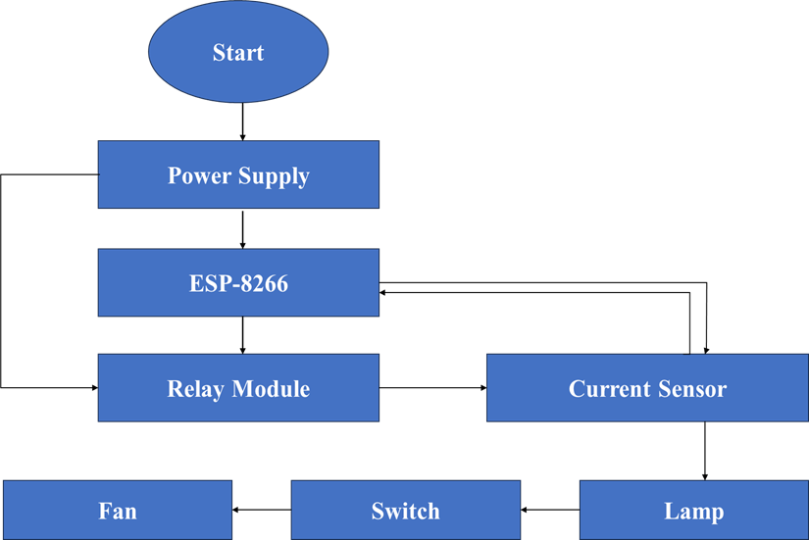
Flow Chart

Slide 7
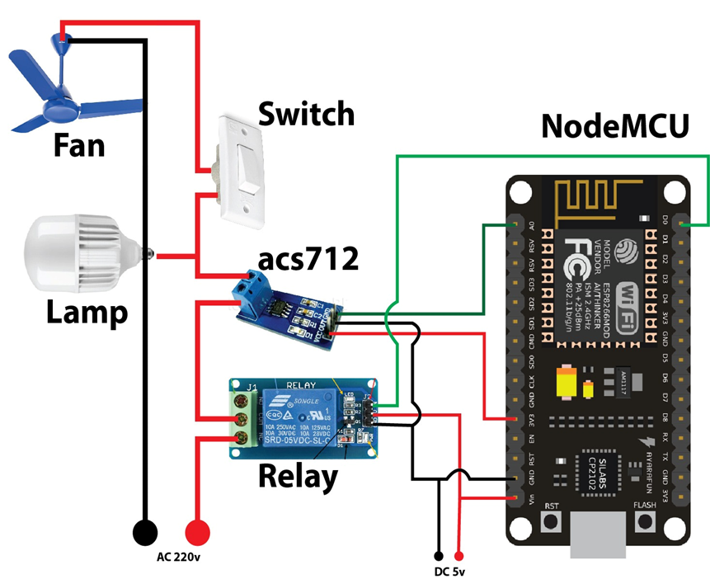
Circuit Diagram of the Project

Slide 8
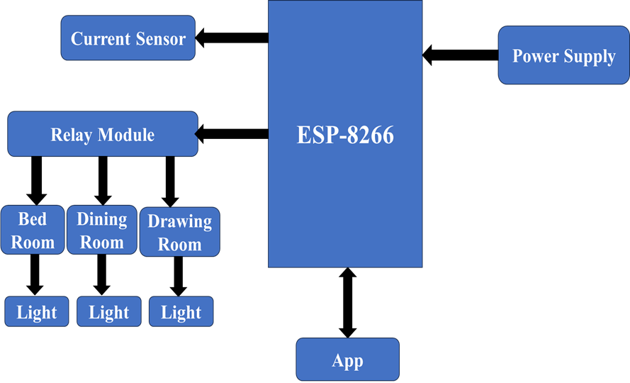
Block Diagram of the Project

Slide 9
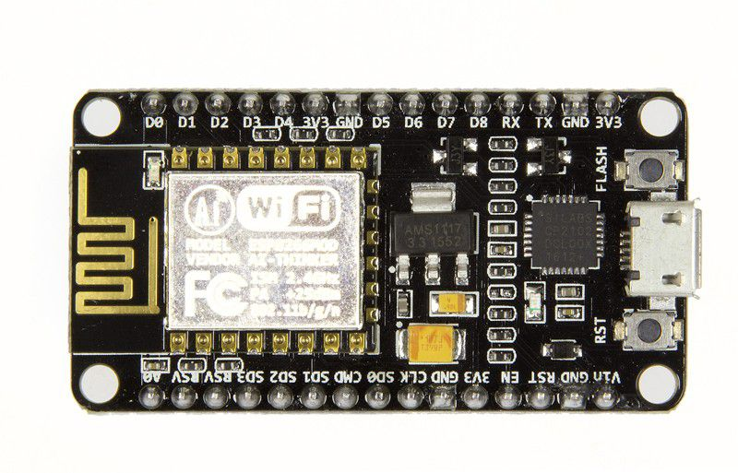
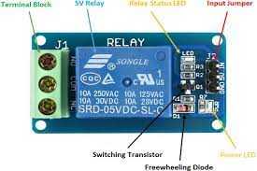
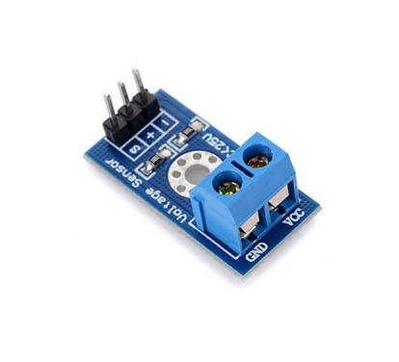
Components
ESP 8266
Relay Module
Current Sensor

Slide 10
Main Controller ESP 8266
Microcontroller: Tensilica 32-bit RISC CPU Xtensa LX10654 Digital I/O terminals (14 of which have programmable PWM outputs).
Operating Voltage: 3.3V4 UARTs (hardware serial ports).
Digital I/O Pins (DIO): 16
Analog Input Pins (ADC): 1
Clock Speed: 80 MHz
Small Sized module to fit smartly inside your IoT project
Flash Memory: 4 MB

Slide 11
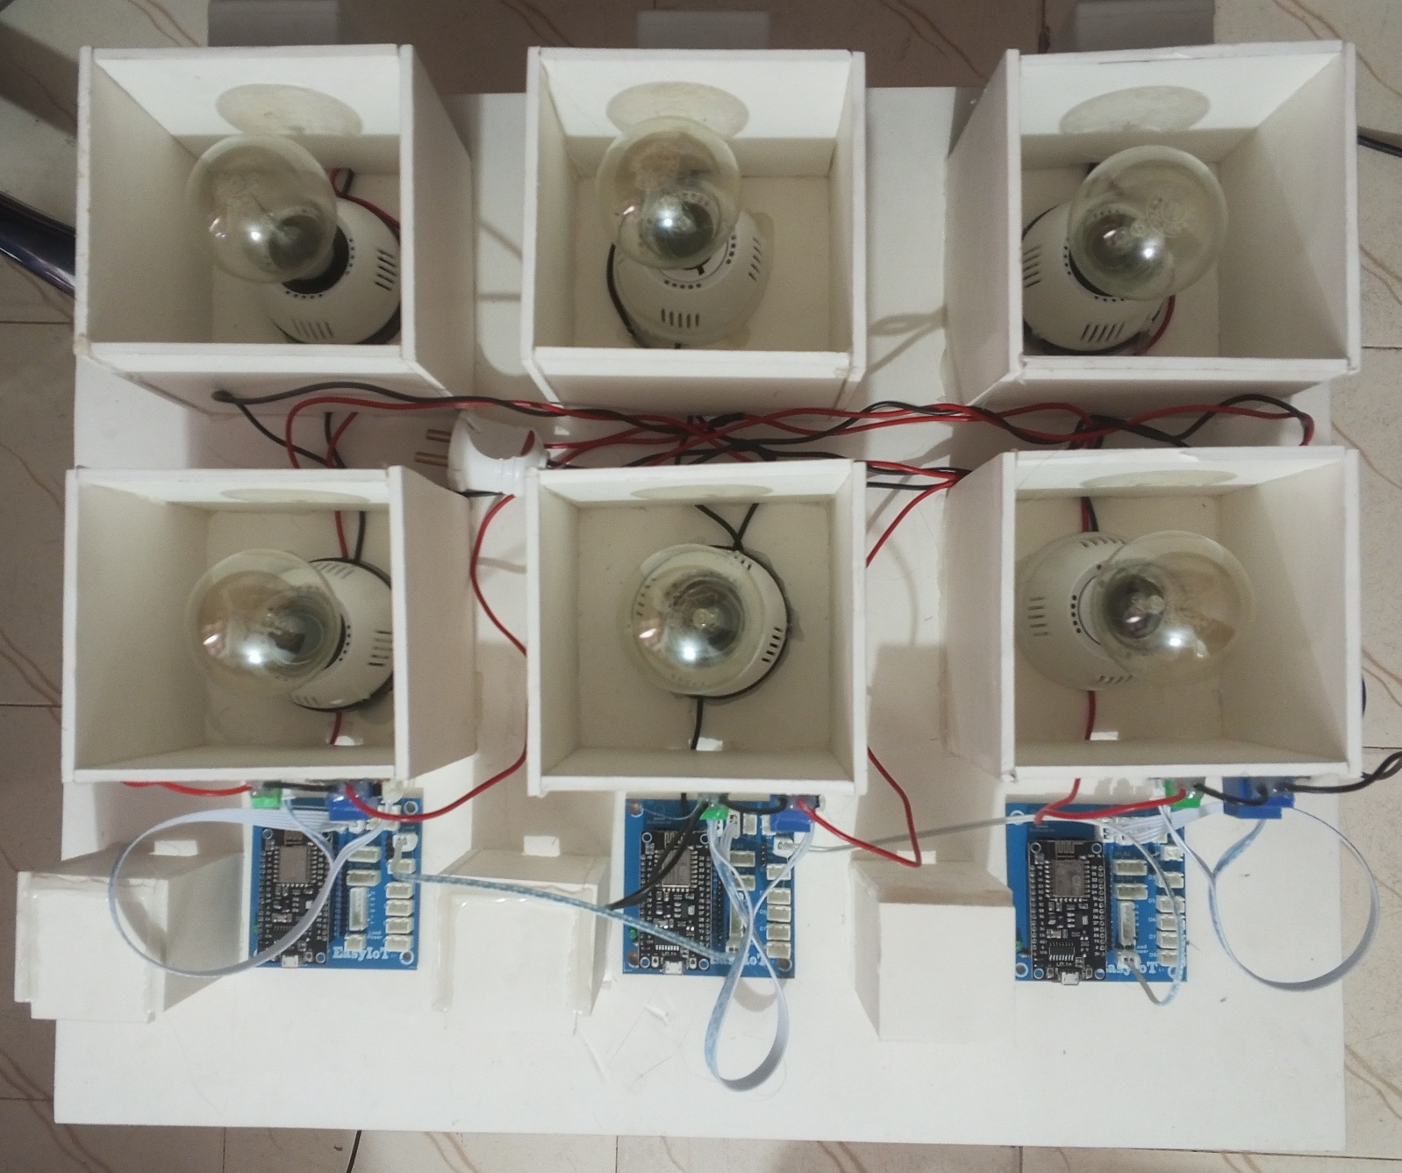
Project Picture

Slide 12
Calculation
Data Calculation
Voltage, V = 220 V
Current, I = Current sensor measured Amp.
We know,
1kWh = 1Unit
Power, P = V*I=220 * .45455 = 100 Watt = .1 KW = .1 kWh = .1 / 60 unit
Here we calculate Per-minute Power Consumption
Electric bill per unit = 6.42 Taka = 642 coins
Electric bill per minute = P * 400 = (.1/60) * 642 = 1.07 coins per minute

Slide 13
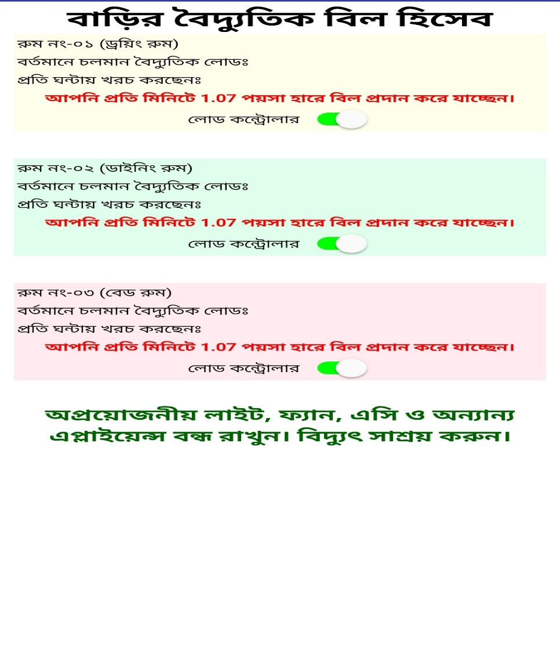
Result

Slide 14
Applications
The equipment and machinery used to make production more efficient are referred to as automation in the textile industry. Automation has several advantages, including fewer work hours for the same amount of output, better working conditions, and a higher-quality product.
Automation, also known as automatic control, is the use of various control systems to operate equipment such as machinery, factory processes, boilers, heat-treating ovens, telephone network switching, ship steering and stabilization, and other applications and vehicles with minimal or no human intervention.
This system is more compact and reliable as compared to the electrical power system.

Slide 15
Future Scope
The project aims to monitor and regulate loads in various industries, including residential homes.
It will expand its reach with GPRS technology, enabling global transmission of controlled information.
The current sensor will manage load current, while a voltage and frequency sensor will be added for controlling voltage and frequency.

Slide 16
Conclusion
The prototype uses a mobile device and internet to control and monitor room locations. It uses relay switches, current sensors, and an ESP-8266 modem. The Arduino current sensor sends data to a database, while the mobile device regulates load. The Android app allows operators to handle loads from anywhere, eliminating the need for skilled operator analysts and programmers.

Slide 17
Reference
Kumar, Anil, Saleh A. Alghamdi, Abolfazl Mehbodniya, Julian L. Webber, and Shavkatov Navruzbek Shavkatovich. "Smart power consumption management and alert system using IoT on big data." Sustainable Energy Technologies and Assessments 53 (2022): 102555. [1]
Chaudhari, Sneha, Purvang Rathod, Ashfaque Shaikh, Darshan Vora, and Jignesha Ahir. "Smart energy meter using Arduino and GSM." In 2017 International Conference on Trends in Electronics and Informatics (ICEI), pp. 598-601. IEEE, 2017. [4]
Marques, Gonçalo, and Rui Pitarma. "Monitoring energy consumption system to improve energy efficiency." In Recent Advances in Information Systems and Technologies: Volume 2 5, pp. 3-11. Springer International Publishing, 2017. [6]
Abubakar, I., S. N. Khalid, M. W. Mustafa, Mamunu Mustapha, and Hussain Shareef. "Residential Energy Consumption Management Using Arduino Microcontroller." Advanced Science Letters 24, no. 6 (2018): 3887-3893. [8]

Slide 18
Thank you very much.

Slide 19
Do you have any questions?

