Slide 1
Welcome to our Project Presentation

Slide 2
Project Name:
Design and Implementation of Smart Vacuum Cleaner Robot

Slide 3
Our copartners & Supervisor are
Md. Masum Hossain ME-1901017275 | Md. Fareduzzaman Shafi ME-2101023398
Chayon Kumar Sarker ME-2101023489 | Jayanto Mohan Roy ME-2101023190
Sheikh Fahim Morshed ME-2101023484 | Jewel Rana ME- 2101023478
Supervised By:
Niloy Sarkar
Assistant Professor
DEPARTMENT OF MECHANICAL ENGINEERING
SONARGAON UNIVERSITY (SU)

Slide 4
Contents:
Introduction
Objectives
Components
Block Diagram
Circuit Diagram
Working Process
Flowchart
Project Picture
Cost Analysis
Market Analysis
Advantages
Application
Future Implementation
Conclusion

Slide 5
Introduction
In the current hectic schedule, cleaning houses and the surrounding environment is more arduous. At present, there are vacuum cleaners that require humans to handle it. Thus, there is a dire need to implement vacuum cleaner which works without human intervention. Having our surroundings clean is not only a daily habit, but also a vital component that has a significant influence on our general wellbeing. Even while dusting and sweeping are popular cleaning techniques, it's crucial to recognize that these actions may unintentionally expose us to allergens and dangerous particles, thus jeopardizing our health. An automated vacuum cleaner that used an Android device as a remote control was created in response to this challenge. An efficient method to clean the desired area has been implemented through this project. This solution combines necessary parts, such as the Arduino Uno microcontroller, HC-05 Bluetooth module, and Motor Driver Shield L293D, to enable simple operation via Android devices. This automated vacuum cleaner prototype has the potential to completely change the way we maintain our living environments by providing a new, easy-to-use, and affordable cleaning method.
.

Slide 6
Objectives
The objectives of our project are:
To study about a smart robot vacuum cleaner.
To design a model vacuum cleaner robot.
To construct a robot vacuum cleaner using purchased parts & sensor.

Slide 7
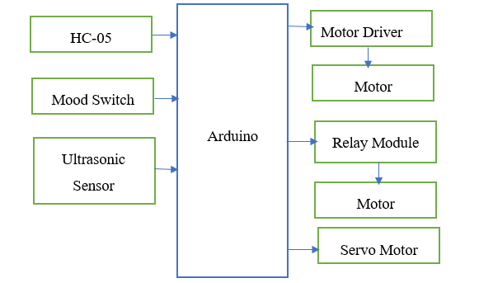
Project Diagram

Slide 8
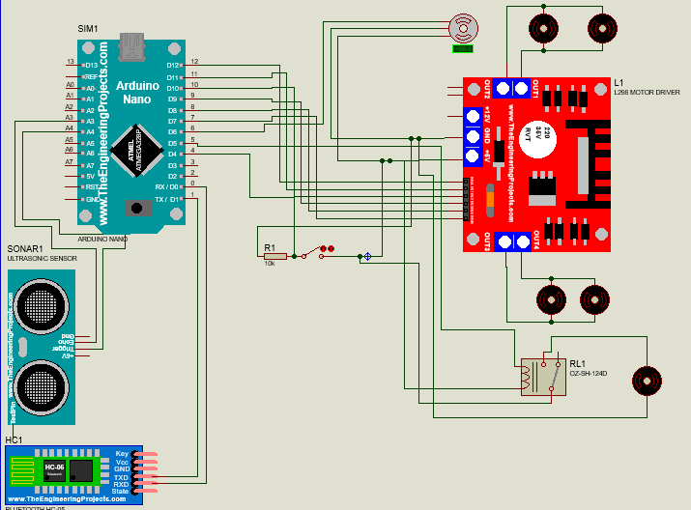
Circuit Diagram

Slide 9
Working Process
The fundamental operating principle of the perfect vacuum cleaner is this phenomenon. A centrifugal fan moves the air by introducing external kinetic energy to it while it turns. Negative pressure is created behind the fan as air is drawn in from behind and forced forward with it. This centrifugal fan, which is attached to a motor, is found in the ultimate vacuum cleaner. This device has connections for suction and discharge; on the suction side, a filter bag is installed before the hose connection. The discharge is open to the atmosphere and features a second air purifier filter. The motor and centrifugal fan both rotate when electricity is applied. All airborne particles, including cat allergen, mist, dirt, and minute solid particles, are delivered to the suction filter together with the air that is drawn into the device from the suction side. Filtered air is forced out of the discharge aperture while the particles are trapped in the filter.

Slide 10
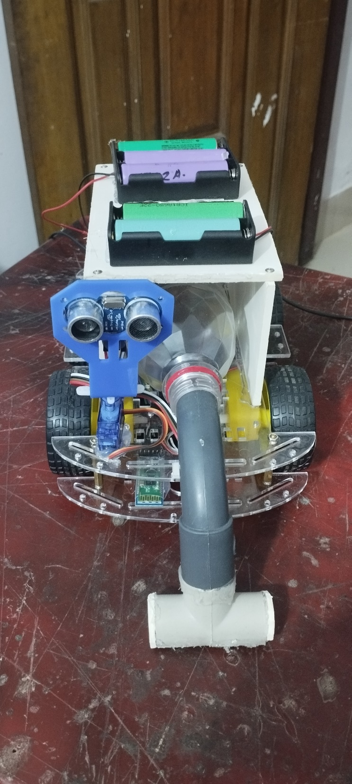
Project Pictures

Slide 11
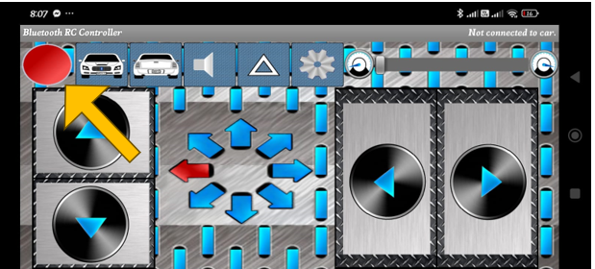
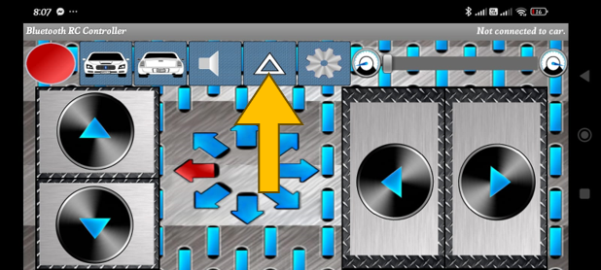
Setup RC Bluetooth Car Apps
When connected with robot then this marked color green. If disconnected from robot then its color is red.
If want to turn on Vacuum cleaner then press this arrow button from RC Car Apps.

Slide 12
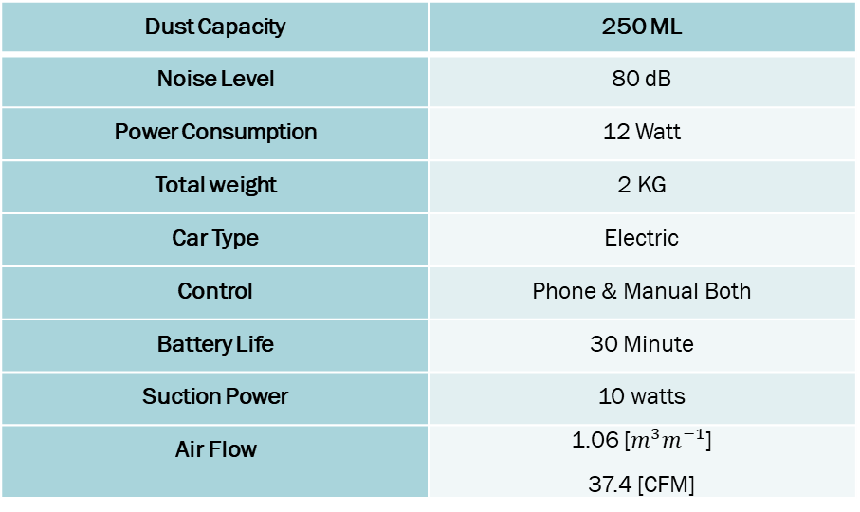
Data of our project
Dust Capacity | 250 ML
Noise Level | 80 dB
Power Consumption | 12 Watt
Total weight | 2 KG
Car Type | Electric
Control | Phone & Manual Both
Battery Life | 30 Minute
Suction Power | 10 watts
Air Flow | 1.06 [$m^{3}m^{−1}$] 37.4 [CFM]

Slide 13
Cost Analysis
Serial No | Components name | Price
01 | Arduino nano | 440/=
02 | 4WD car | 950/=
03 | 3.7V battery | 450/=
04 | Case | 120/=
05 | Charger | 175/=
06 | Air motor | 350/=
07 | Relay module | 90/=
08 | Ultrasonic | 90/=
09 | Motor driver | 190/=
10 | Servo motor | 135/=
11 | Servo mount | 44/=
12 | HC-05 | 350/=
13 | Switch | 20/=
14 | Setup | 1700/=
 | Total= | 5104 Taka Only

Slide 14
Advantages
Cost-effective: Arduino-based smart vacuum cleaners are relatively inexpensive compared to commercially available vacuum cleaners, making them a cost-effective option for those on a budget.
Customizable: Arduino provides a platform for developers to customize their smart vacuum cleaners, allowing them to add features that meet their specific needs.
User-friendly: Arduino's programming environment is user-friendly, making it easier for non-programmers to create their smart vacuum cleaner.
Scalability: The modular design of Arduino boards allows users to easily upgrade or add new features to their smart vacuum cleaners as needed.
Flexibility: With an Arduino-based smart vacuum cleaner, users can choose to use different sensors, motors, and other components, allowing for greater flexibility in terms of design and functionality.

Slide 15
Application
Floor Scrubbers: They are widely used in schools, hospitals, hospitality, and retail environments.
Sweepers: A sweeper can be used indoors or outdoors to collect dust, and dirt.
Steam cleaners: They use high-temperature steam to remove dirt, destroy viruses, disinfect, sanitize deodorize different types of floor surfaces and can be used in above-ground surface cleaning.
Carpet Cleaners and Extractors Cleaners.

Slide 16
Future Implementation
The future work of robots may include
Image/video captured of objects can be fed to the controller so that the robot can clean the entire house according to the input fed.
Currently, the image is captured only for edge detection for movement in the proper path, not for object detection.
The cleaning mechanism on the robot can be replaced by a handlike structure so that it can lift things from one place to another.
Voice-controlled locomotion of robot instead of remote control.
Automatic charging.

Slide 17
Conclusion
In conclusion, this project has explored the design and implementation of an autonomous floor-cleaning robot controlled via Bluetooth technology. We aimed to bridge the gap between traditional robotic control interfaces and modern user expectations for wireless, smartphone-based control. Through the development of our robot, we have successfully integrated Bluetooth communication, allowing users to control and monitor the robot conveniently from their smartphones. This innovation enhances user experience, making floor cleaning more accessible and adaptable to modern smart home environments.

Slide 18

Thank you

