Slide 1

Fabrication of Fire Fighter Robot
Presented by
Md Samiuzzaman
ME2102024305
Md. Zamilur Rahman
ME2102024167
Md. Sabbir Hossain ME2102024326
Md Arifur Rahman
ME2102024306
Rahim Islam Rifat
ME2102024255
MD. Manjurul Haque
ME2102024118
Supervised by...
Md.Minhaz Uddin
Assistant Professor
Dept. ME, SU
Department of Mechanical Engineering
Sonoran University (SU)

Slide 2
Outline of Presentation
Intorduction
Objectives
Methodology
Working Principle
Required Component
Block Diagram
Circuit Diagram
Hardware Implementation
Complete Project Prototype
Result
Advantage
Calculation
Application
Future Scope Of Work
Conclusion

Slide 3
Introduction
A firefighter robot is an advanced autonomous system designed to assist in firefighting operations, enhancing safety and efficiency. These robots are equipped with specialized sensors, cameras, and firefighting tools to detect fires, navigate hazardous environments, and extinguish flames. They can access areas too dangerous for human firefighters, such as collapsed buildings or hazardous chemical sites. Some models are capable of operating in extreme heat and toxic conditions, while others may assist with search-and-rescue operations. Firefighter robots offer a promising solution to reduce human risk in dangerous fire scenarios while improving response times and operational effectiveness.

Slide 4
Objectives
We have some specific objectives for this project and they are pointed below:
Design and Construct of a Fabrication of Fire Fighter Robot
Detect an unwanted fire issue and send it the user.
Bringing the whole prototype under several tests by creating different situations to validate our work.
Taking notes from our real-time tests so they can be used for future improvement.

Slide 5
Methodology
Our used methodology for the project:
Creating an idea for the design and construction of Fabrication of Fire Fighter Robot. And designing a block diagram & circuit diagram to know which components we need to construct it.
Collecting all the components and programming the microcontroller to control our desired system.
Setting up all the components in a PCB board & soldering. Then assembling all the blocks in a board and finally running the system to check if it actually works or not.

Slide 6
Working Principle
The power supply section of this circuit consists of DC Battery. In this project we use a Arduino Nano micro-controller as a main controller. Here we also use Battery,Buck Converter, Flame sensor, Servo Motor, Pump Motor,Gear Motor, Motor driver etc The main purpose of our project is to detect fire and extinguish fires. Also monitoring distance, temperature, smoke etc.
When we first on the project, the project will be able to move with the help of the gear motor. This robot is controlled by human. When a rescue team went to extinguish fire then they will check inside situation. Then our system will be very useful to them. They can inside gas condition, fire condition, smoke condition .Then they enter there and extinguish the fire easily. that’s why fire fighter death rate will be reduce . This is the main procedure and aim of our project.

Slide 7
Required Component
Arduino Nano
Motor Driver
Gear Motor
Wheel
Relay Module
Flame Sensor
Pump Motor
Servo Motor
Battery
Buck Converter

Slide 8
Block Diagram
Adapter
Battery
Buck Converter
Arduino
Nano
Relay Module
Water Pump
Flame Sensor
Motor Driver
Gear Motor
Servo Motor

Slide 9
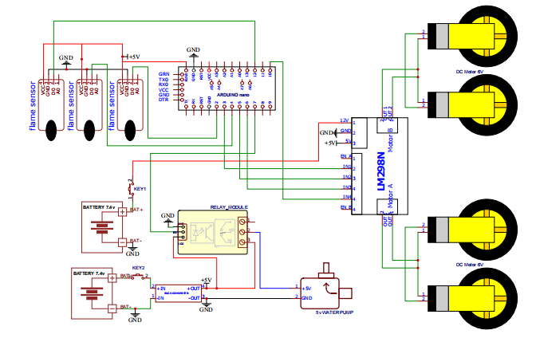
Circuit Diagram

Slide 10
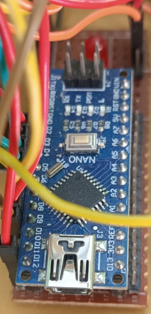
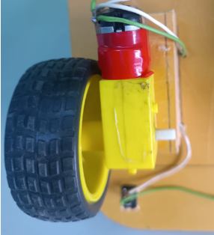
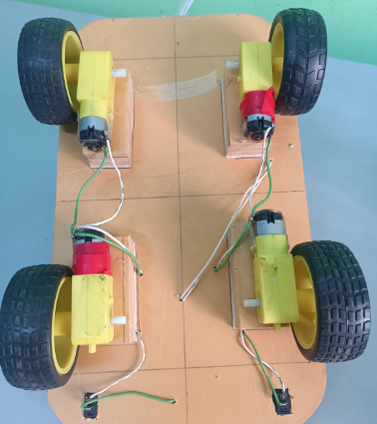
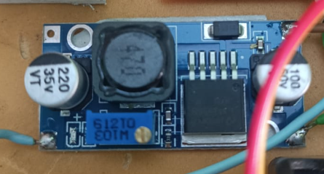
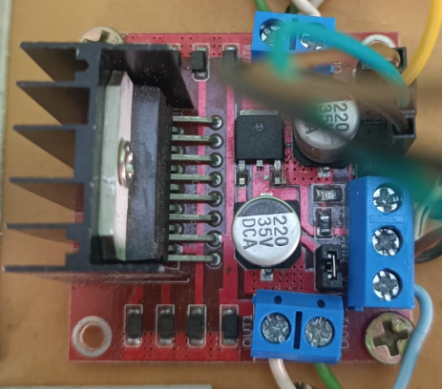
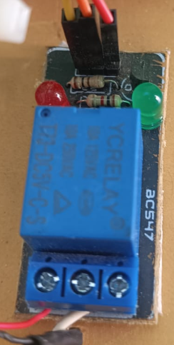
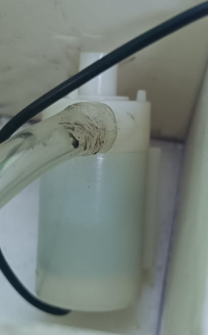
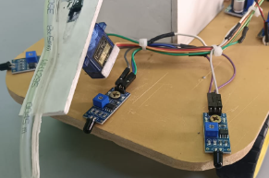
Hardware Implimantation

Slide 11
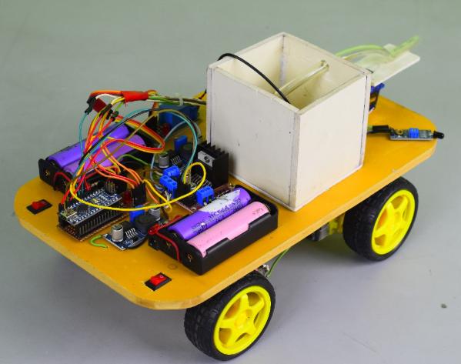
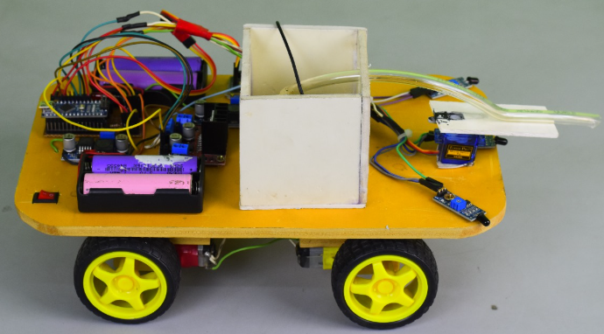
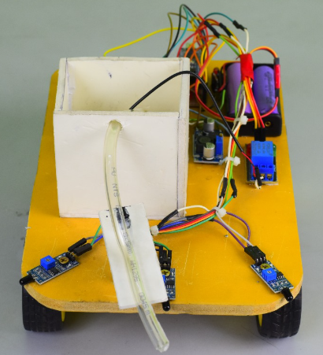
Complete Project Prototype

Slide 12
Expected Result
After making our project we observe it very careful. It works as we desire. Our project give output perfectly and all equipment are work perfectly. We check how much it works and we get perfect output from this project.
Finally, we have completed our project successfully & check our project its run accurately according to our objective.
The vehicle was moved and when detect fire then fire sensor give a signal to micro-controller.
After sensing the fire, we will spray the water and extinguish the fire.

Slide 13
Advantage
There are certainly many advantages of our project and some of the major ones have been given below:
Able to take action for fire protection.
The system is user friendly.
Able to detect fire.
Able to detect smoke
Portable.
Cost Effective.
High Accuracy.

Slide 14
Calculation
We have the following specifications for the robot:
Battery qty 2 for motor
Battery Capacity: 3000 mAh
=300*2 mah
=6000 mah
Rated Voltage: 3.7 volt
=3.7*2 V
7.4 V
Power Consumption: P=VI​
=12V×2A
=24W
Movement Speed: V=(2π*RPM*r)/60
= (2π*150*0.03)/60
=47 cm/sec
Water Discharge Rate: 80 L/hr
=1.33 L/min
Tank Capacity: 0.5 L
Time for full suppression=(.5L/1.33 L/min)
=0.37 minutes

Slide 15
Calculation
total fire suppression capacity=Flow rate×Time available for suppression×Efficiency factor
=1.33*0.37*.50
=0.06 m²/min
Battery Life:
Convert battery capacity to watt-hours:6,000 mAh
= 6 Ah.
Assume a voltage of =7.4 V
Battery Energy = 6Ah × 7.4 V
= 44.4 Wh.
Battery Life = 44.4 Wh / 24 W
= 1.85 hours.

Slide 16
Calculation
Distance Traveled (in 1.85 hours):
Distance = 0.47 m/s × (1.85 hours × 3600 seconds)
= 3130 meters
= 3.13 km.
Time to Extinguish Fire:
Let’s assume the area of the fire is 0.5 m².
Time = 0.5 m² / 0.06 m²/min
= 8 minutes.
Water Supply Duration:
Time = 0.5 L / 1.33 L/min
= 0.37 minutes
Detection Angle :60 degree

Slide 17
Application
The application areas for this project in this modern and practical world are huge and some of these are given below:
Analyzing and locating fires
Conducting search and rescue
Monitoring hazardous variables
The primary task of fire control and suppression.
      ➢At power plant control rooms.
      At captain bridges.
      ➢At flight control centers.

Slide 18
Future Scope of Work
We have lots of future scope of work available to us for this project. Some of these are listed below:
In future, we make it more efficient.
In future, we are thinking about adding more features to the system such as sensor and monitoring cameras.
In future we will improve IoT. It will detect every side of angle by IoT.
In future we are thinking about adding fire extinguisher.

Slide 19
Conclusion
The circuit of our project was designed and setup using Arduino Nano which is very reliable & stable. In the fire extinguishing robot project, we developed a system that detects and extinguishes the fire before the fire starts and informs the electronic environment. Here targets are micro-controller and motor control with reductive motor, flame detection with fire Sensor, smoke detect, temperature detect. The robot which is designed here as a result of this study communicates through the serial port via the serial port and processes the analog and digital data received from the sensors in the micro-controller control so as to determine the fire in the open or close environment. In this work, a system that works successfully both hardware and software has been realized. This system "fire detection and extinguishing robot" is capable of being used in our everyday life. Our project have another micro-controller which is . That’s why we inform the all condition surrounding of the robot.

Slide 20
Thank YOU

