Slide 1

WELCOME
TO
OUR PRESENTATION

Slide 2
Department of Mechanical Engineering
Project Tittle :Design and Fabrication of Pick and Place Mechanism for Industrial Applications
Supervised By
Submitted by
Nahiyan Chowdhury
Lecturer
Department of Mechanical Engineering
Sonargaon University
Md. Sourav Mia | ID: ME2102024039
Ratan Dev Adhikary | ID: ME2102024040
MD. Shahazahan Islam | ID: ME2102024020
Md Waliullah | ID: ME2102024045
Nironjon Chandra Das | ID: ME2102024219

Slide 3
Outline
Introduction.
Objectives.
Methodology.
Block Diagram.
Equipment’s
Programming Microcontroller.
Circuit Diagram.
Flow Chart.
Project Picture.
Working Process.
Advantages .
Discussion
Conclusion.
Future Scope.

Slide 4
Introduction
In today’s factories and shop floors, industrial automation is everywhere and it is difficult to imagine a production line without automation. Industrial automation uses control systems and equipment, such as computer software and robots, to perform tasks that were historically done manually. These systems operate industrial equipment automatically, significantly reducing the level of operator involvement and oversight required. One machine/mechanism that is most visible in industrial automation is the Mechanical pick and Place mechanism. Pick and place automation speeds up the process of picking up parts or items and placing them in other locations.

Slide 5
Objectives
Works Automatically.
Pick and place robots handle repetitive tasks while freeing up human workers to focus on more complex work.
With a variety of design options available, pick and place machines can be configured with various end-of-arm tooling options for use in different applications.
The Mechanical Pick & Place Machine, our project, aims to show the simple working of the mechanism.

Slide 6
Methodology
The final objective is to develop a pick and place mechanism which will be able to lift a sensitive object safely. The arm will employ a closed loop control system using the sensor as the input sensor and the computer or microcontroller as the controller and the controller will control the gear motor. We used C to write the program which will control the drive circuit. The data acquisition for the force sensor was done by a data acquisition card.

Slide 7
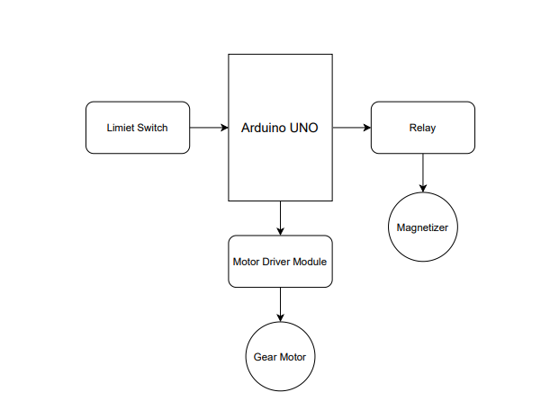
Block Diagram

Slide 8
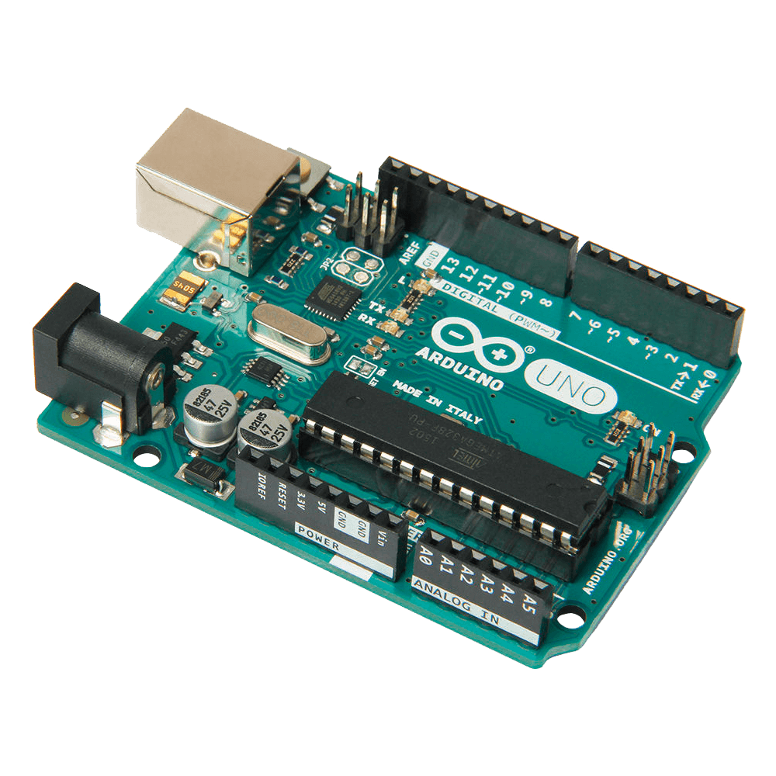
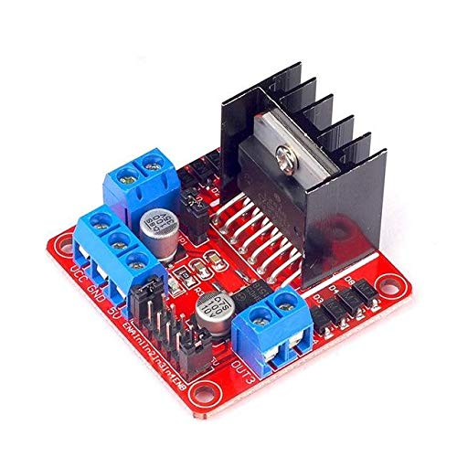
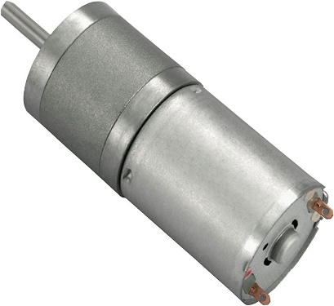
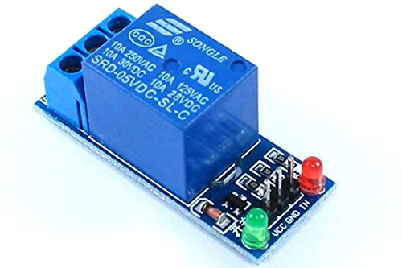
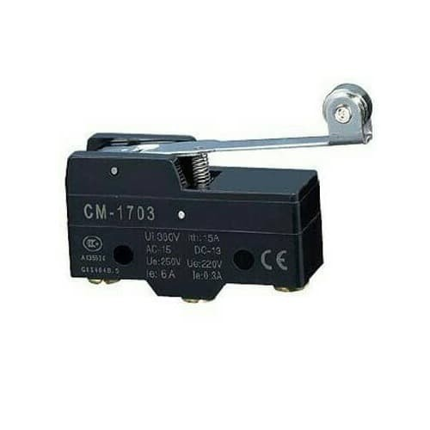
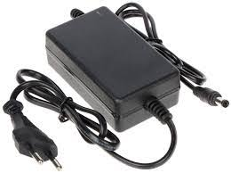
Equipment’s
Arduino UNO
Motor Driver Module
Gear Motor
Relay Module
Limit Switch
Adapter

Slide 9
Programming Microcontroller Arduino UNO
Arduino UNO Atmega328 is open source hardware and microcontroller .
14 Digital I/O terminals (5 of which have programmable PWM outputs).
6 Analog Inputs.
4 UARTs (hardware serial ports).
16 MHz crystal clock.
Operating voltage: 6 ~ 12v.
It has 32 KB flash memory, 2 Kb SRAM and 1 KB EEPROM.

Slide 10
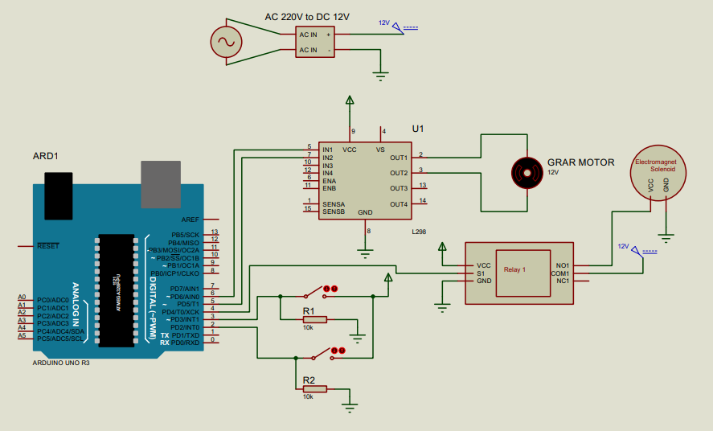
Circuit Diagram

Slide 11
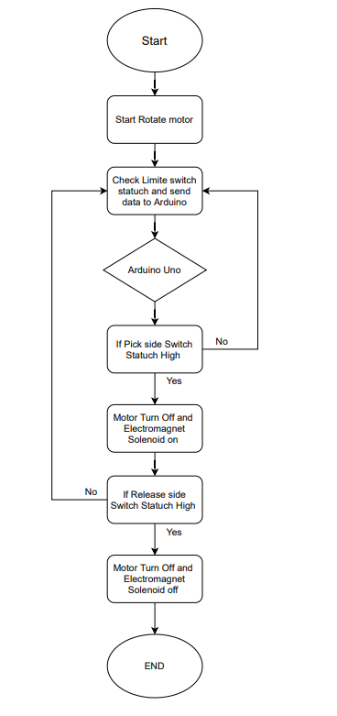
Flow Chart

Slide 12
Project Picture

Slide 13
Working Process
The power source is a simple motor. The motor rotates the pulley with the help of a belt. There is a metal plate with two slots for reciprocating mechanism. One of the reciprocating mechanisms is driven by the pulley. This reciprocating causes the metal plate to oscillate. This oscillating motion is transferred to a spring-loaded part through the second reciprocating mechanism. The spring-loaded tool is attached to the pick and place part. The oscillation of the spring-loaded tool causes the spring to compress and decompress which in turn causes the pick and place part to move back and forth. Pick and place automation speeds up the process of picking up parts or items and placing them in other locations. The mechanism consists of rotating, reciprocating and oscillating motions.

Slide 14
Advantages
Automating this process helps to increase production rates.
Pick and place automation speeds up the process of picking up parts or items and placing them in other locations.
Pick and place robots handle repetitive tasks while freeing uphuman workers to focus on more complex work.
Easy to Install.

Slide 15
Discussion
This Mechanism is used for pick and place the object from one place to another place. Concepts of automobile and robotics are combined in this project. Transmission of power due to meshing of gear motor is used for lifting purpose. Worm drive is also used for power steering. These systems operate industrial equipment automatically, significantly reducing the level of operator involvement and oversight required. Pick and place automation speeds up the process of picking up parts or items and placing them in other locations.
During this period we have been exposed to user friendly environment and real time industrial application development. Because of it we learned skills like team work, working with time bound and dealing with professional persons in Industry.

Slide 16
Conclusion
The mechanism was tested successfully and was capable of picking objects and migrating them across a horizontal, with accuracy, precision and efficiency. The repeatability and speed of operation was high making the Magnet Based Pick and Place Mechanism for Industrial Applications suitable for dexterous tasks. The results obtained were very satisfactory.

Slide 17
Future works
We have successfully completed our project with available sources. But the results and changes do not depend on expectations. This can be further improved by incorporating the following changes to get better results. The process that we used in the Scotch yoke mechanism does not work efficiently. This skill can be enhanced by using some other mechanisms.
Include a high level of movement flexibility.
This will allow the use of advanced sensors.
This project is to give the way for providing bigger effective pick and place mechanism for industrial applications.

Slide 18
Any Question?

Slide 19


