Slide 1

Performance Investigation of a Solar Collector Water Heater Integrated With Photovoltaic Cell
By
Md Tafimul Islam (ID: ME2101023226)
Sariful Islam (ID: ME2201026005)
Sabbir Ahmed Fahad (ID:ME2201026067)
Abdul Latif Miah (ID: ME2201026103)
Md. Toufikuzzaman (ID: ME2201026285)
Supervised By
Md. Toriqul Islam
Lecturer
Department of Mechanical Engineering
SONARGAON UNIVERSITY (SU)
page 01
next

Slide 2
Contents
Introduction
Methodology
Result & Discussion
Future Recommendations
Conclusion
page 02
next

Slide 3

Introduction
page 03
next

Slide 4
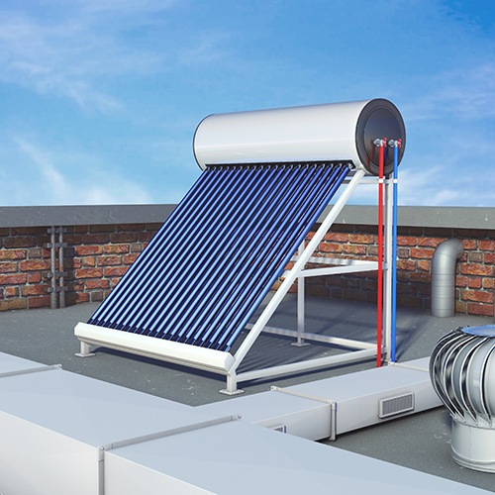
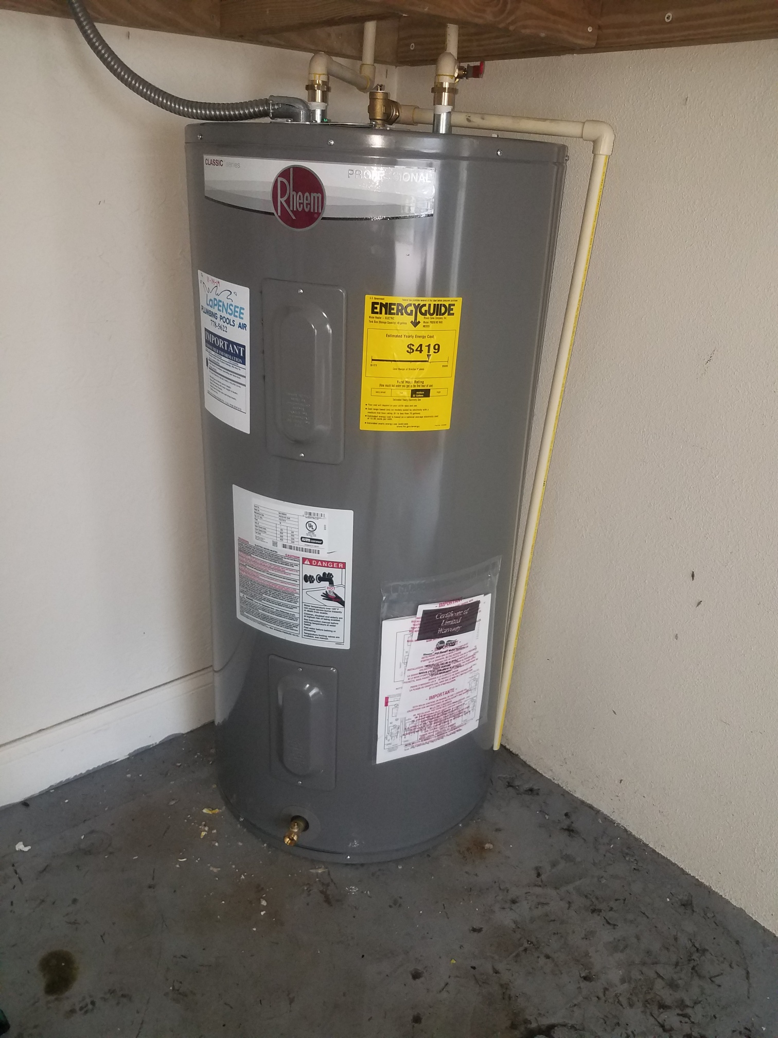
Background & Motivation
Rising energy demand and reliance on fossil fuels
Conventional water heaters consume high electricity
Need for renewable, low-cost domestic water heating in Bangladesh
Conventional energy sources contribute to greenhouse gas emissions and climate change
Integration with photovoltaic (PV) cells allows independent operation without grid power
page 04
next

Slide 5
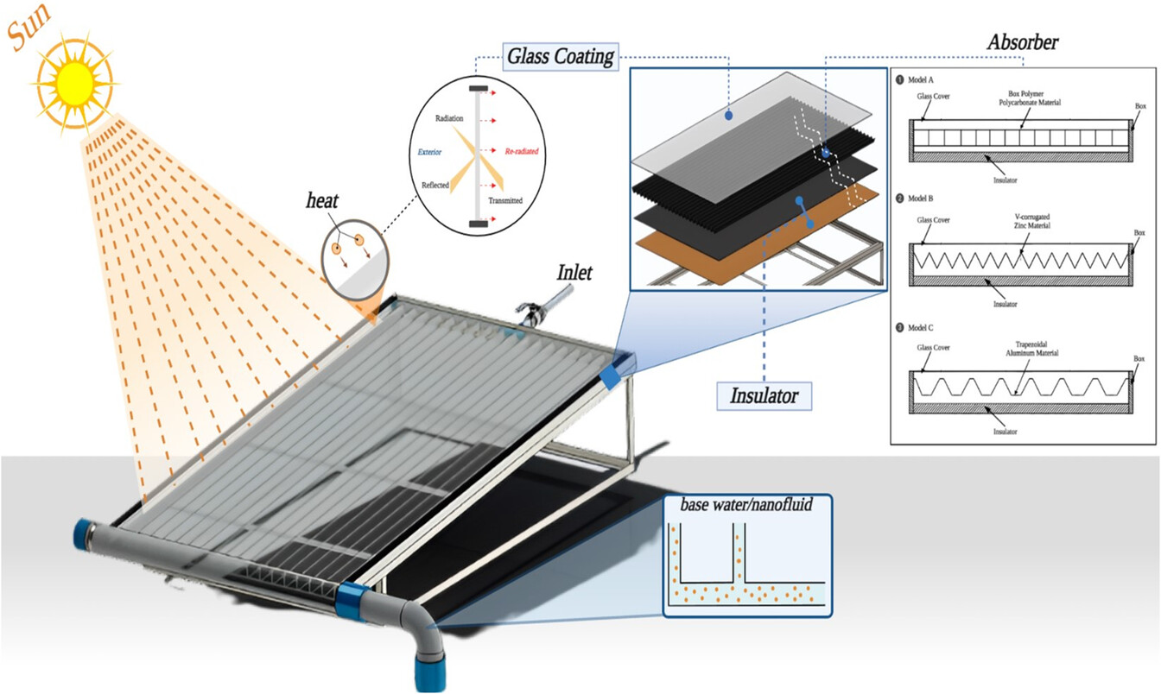
Problem Statement
High electricity & fuel cost for conventional heaters
Heavy dependence on non-renewable sources
Not suitable for rural/low-income households
Reduces fossil fuel use & electricity demand
page 05
next

Slide 6

Objectives
To evaluate the performance of the system in terms of temperature rise, heat transfer, and overall efficiency.
To implement an Arduino-based monitoring system for recording and analyzing inlet and outlet temperatures.
To compare the energy consumption with conventional water heater.
page 06
next

Slide 7

Methodology
page 07
next

Slide 8
Methodology
Water Tank
Pump
Header Pipe In
Header Pipe Out
Use
Open-loop circulation system
Continuous water flow through header pipe
PV-powered DC pump for circulation
Efficient heat absorption via ethanol-filled copper heat pipes
Self-sustained operation with photovoltaic module
Low-cost fabrication using local/repurposed materials
Real-time temperature monitoring at key points
page 08
next

Slide 9
Construction Process
Fabrication of Heat Pipes
Construction of Header Pipe
Circulation System
Temperature Monitoring System
Page 09
next

Slide 10
Construction Process
Header Pipe
Temperature Monitoring System
Fabrication of Heat Pipes
Pump
Page 10
next

Slide 11

Result & Discussion
page 11
next

Slide 12
Experimental Data
Temperature (◦c)
Time Day | 11.00 am | 11.30 am | 12.00 pm | 12.30 pm | 01.00 pm | 01.30 pm | 02.00 pm | 02.30 pm | 03.00 pm | Avg. Temp Increase
Day 01 | 9 | 9 | 9.5 | 10 | 11 | 11.5 | 12.5 | 13.5 | 13 | 11
Day 02 | 13.5 | 13.5 | 13 | 14.5 | 14.5 | 14.5 | 14 | 13.5 | 13 | 13.77
Day 03 | 10 | 9 | 9.5 | 10.5 | 9 | 10.5 | 11 | 10 | 9.5 | 9.88
Day 04 | 11.5 | 12 | 12.5 | 13 | 13.5 | 13 | 13.5 | 13 | 13 | 12.77
Day 05 | 9.5 | 10 | 10.5 | 11 | 11 | 12 | 12 | 12 | 12 | 11.11
Day 06 | 11.5 | 12.5 | 12.5 | 13 | 13 | 13 | 13.5 | 14 | 13.5 | 12.94
Day 07 | 9.5 | 10 | 10 | 11 | 12 | 13.5 | 13.5 | 13.5 | 13 | 11.77
page 12
next

Slide 13
Time vs Temperature Graph
Temperature
page 13
next

Slide 14

Performance Analysis
Inlet temperature: 28–30 °C
Outlet temperature: 37–44 °C
Average temperature rise (ΔT): 11–13 °C
Maximum recorded ΔT: 14.5 °C
(Day 2, 12:30–1:30 PM)
i.e: System consistently heats water by ~12 °C, suitable for domestic use
page 14
next

Slide 15
    Comparison with Conventional Electric Water Heater
Conventional Water Heater (Using Grid Power)
As Reference: 2 kW, 50 L electric heater raises water from 28 °C to 40 °C (ΔT = 12 °C)
The required energy, Q = m ⋅ Cp ​⋅ ΔT
= 50 × 4.18 × 12
= 2508 kJ ≈ 0.70 kWh
Solar Water Heater
The Solar water heater raises temperature of 50 L water from 28 °C to 40 °C (ΔT = 12 °C)
The required energy (Grid Power) = 0
page 15
next

Slide 16
Annual Saving
The PV-powered pump (30 W panel + 12 V DC pump) operated without grid electricity, whereas the electric heater consumes 0.70 kWh per 50 L cycle.
Projected annual consumption of grid power (365 days),
0.70 × 365 = 255 kWh/ year
Annual expense on grid power = 255 kWh/ year × 9 BDT = 2,295 Taka
(At an electricity tariff of 9 BDT/kWh)
Solar powered water heater saves approximately 2,295 taka per year for a 50 L water heating cycle everyday.
page 16
next

Slide 17

Future Recommendations
page 17
next

Slide 18

Future Recommendations
Incorporation of Phase Change Materials (PCM).
Application of Selective Coating.
Integration of Solar Tracking System.
Use of Alternative Materials.
page 18
next

Slide 19

Conclusion
page 19
next

Slide 20
Conclusion
Aim: Improve heat transfer in low-cost evacuated tube solar collector
Fabricated system raised outlet temp by 11–14 °C (peak 43–44 °C)
Comparable to 2 kW electric heater but no grid electricity used
Efficiency: 12–18% vs. 35–45% (commercial systems) → acceptable for low-cost build
Shows feasibility of ethanol-copper heat pipes + PV circulation
Affordable, sustainable alternative for domestic electric water heating in Bangladesh
page 20
next

Slide 21

page 21
next

