Slide 1





SUBMITTED TO
Md. Fakhrul Abedin (Himel)
Lecturer
Department of Textile Engineering,
Sonargaon University
146Mohakhali,WirelessGate.Dhaka.

Slide 2
Submitted By
Name ID Batch
Md Shobuj Mia Tex1802014003 14B
Rajon Tex1802014059 14B
Afjal Hosan Tex1802014050 14B

Slide 3
Presentation
A Project on line cost Minimization and Protection improvement.
Declaration
We are declaring that this is a project thesis report is submitted for
fulfillment of the requirement of BSc in Textile Engineering Degree
of Sonargaon University (SU). We completed the paper with the
help of a knit composite industry. We collected all information,
reports from the industry. All information in this paper is genuine
& correct. We also declare that neither this report nor any part of
this report has been submitted elsewhere for award of any courses.

Slide 4
Acknowledgement
In the name of ALLAH, the most kind and most merciful, First of all, we are grateful to ALLAH ALMIGHTY, who bestowed us with health, abilities and guidance to complete industrial training and this report in successful manner.
Our university has given us the wonderful opportunity to perform our project work. At first, we would like to extend honorable to Md. Selim Lecturer Textile department and supervising Teacher of the university to give us the great opportunity to fulfill of this project work.
We would like to acknowledge our deep debt to all teachers of our University and especially of ‘Apparel Manufacturing Technology’ department for their help and kind inspiration, which remain us the backdrop of our efforts.
We would like to thank the management of the Esquire Knit Composite LTD. for giving us the opportunity to complete the industrial training successfully and for their valuable suggestion. Our deepest gratitude goes to Engr. Jonayad Hossain for facilitating our internship program there and Engr. Prabhakar Gupta Rauniyar, Manager of Industrial Engineering for giving us valuable instruction and guideline. We would also like to thank specially our senior brothers and sisters working there efficiently as textile engineer. Our gratitude also goes to all executives, senior executives and other officials, employees of Esquire Knit Composite Limited for their sincere cooperation, support and valuable advices.

Slide 5
Abstract
Bangladesh's export revenue carries more than 76% contribution from the Textile and Apparel industries. In sewing floor there are several problems which hamper the productivity and efficiency and thus we do not get desired output. This paper, we discussed about the idle time which occurs in sewing line, how these idle times can be reduced by proper line balancing and time study. If idle time can be reduced then the productivity and efficiency of the sewing line can also be increased. Line balancing and time study are important stage in any garment industries. In this paper, we are comparing the productivity and efficiency of three different style sewing line. From the evaluation of the reports, we are trying to minimize the idle time of a line. The objective of this study is to learn about the idle time minimization and how much the productivity and efficiency are affected by means of suitable use of time study, method study, capacity find out about and via appropriate line balancing. If we capable to reduce the idle time it will help to optimize the productivity, efficiency and man, machine, material will be properly used.

Slide 6
Introduction
Textile industry is one of the world's significant businesses also, the piece of clothing industry is a considerable one inside the inventory network of material industry. The generation procedure pieces of clothing are isolated into four primary stages: planning or garments design age, texture cutting, sewing, and pressing or pressing. The most basic stage is the sewing stage, as it for the most part includes an incredible number of tasks. The sewing line comprises of an arrangement of workstations in which a particular assignment in a predefined grouping is handled. As a rule, one to a few undertakings is gathered into one workstation. [1] Errands are doled out to administrators contingent upon the requirements of various work ability levels. At long last, a few workstations in arrangement are shaped as a sewing line.

Slide 7
Materials & Method
Both side Tap
Plastic Board
Binding Tap
Templet Cutting Machine

Slide 8
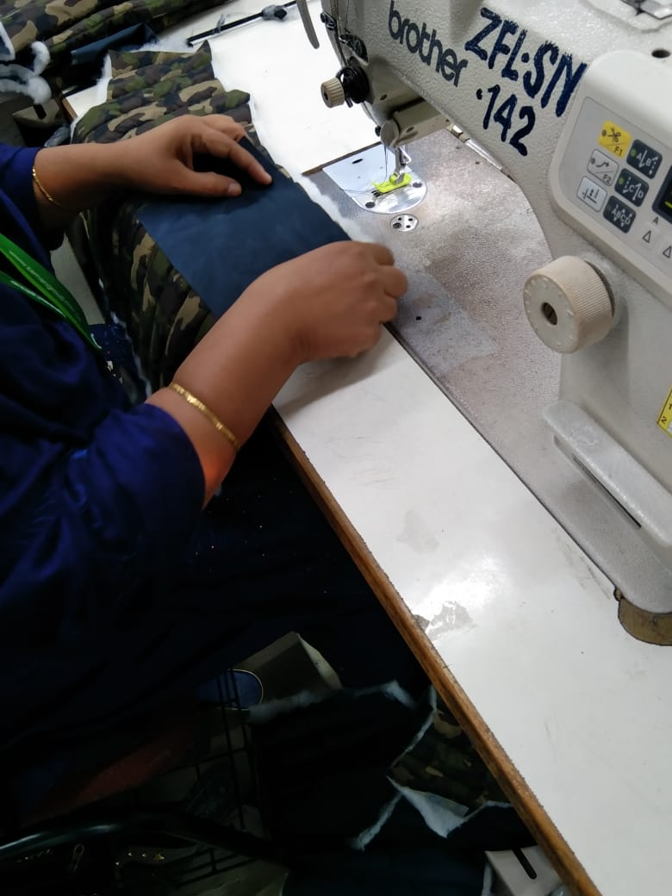
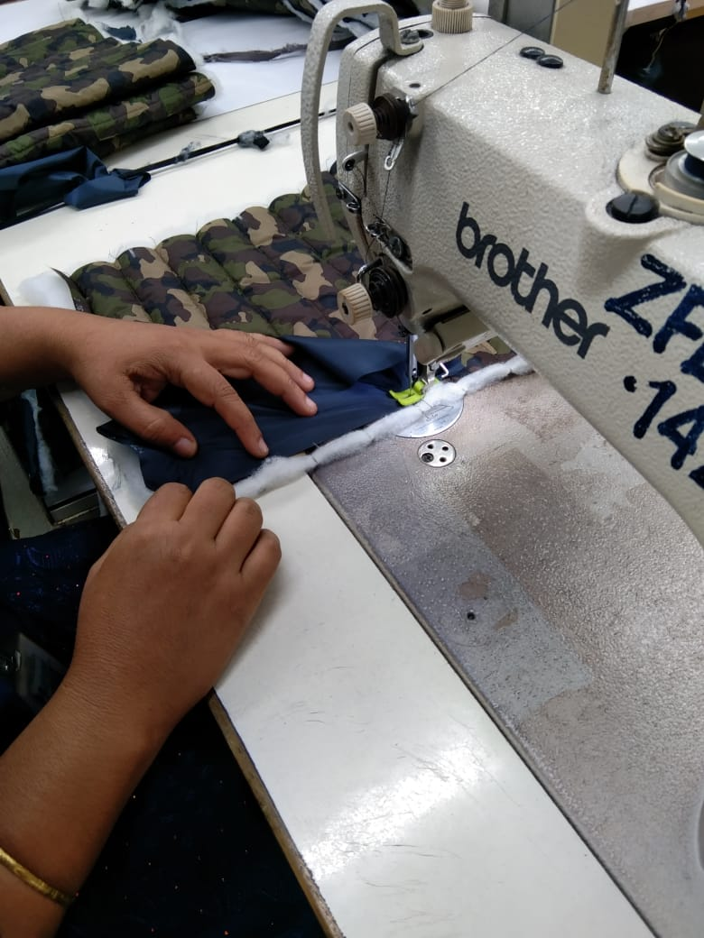
Before

Slide 9
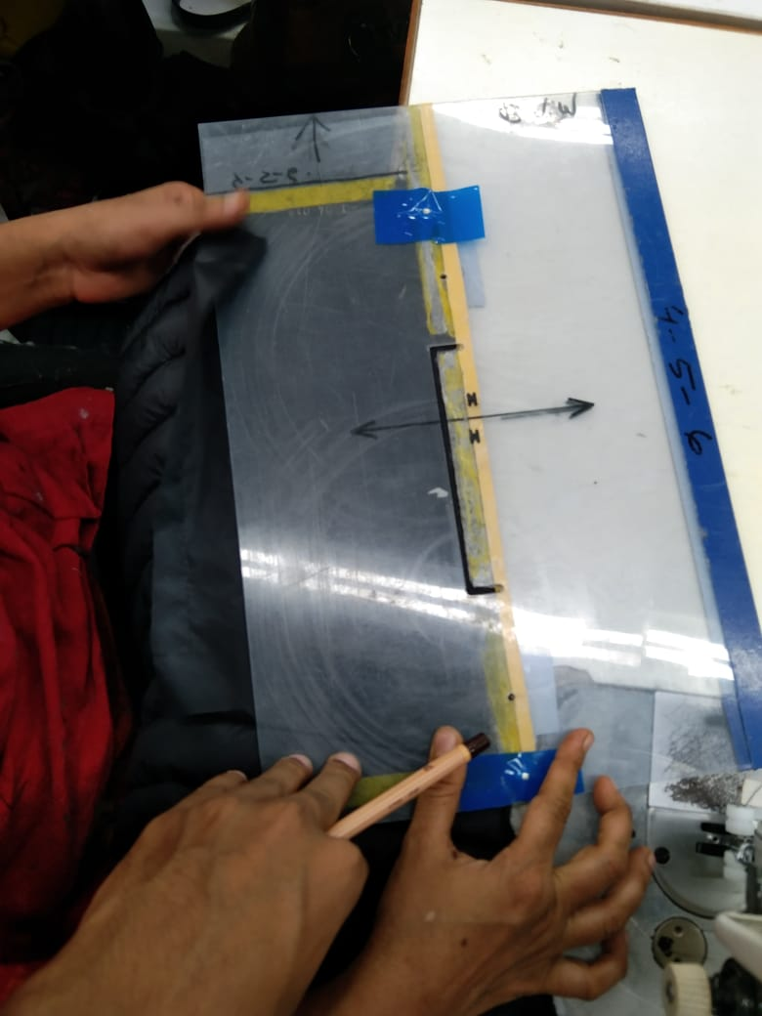
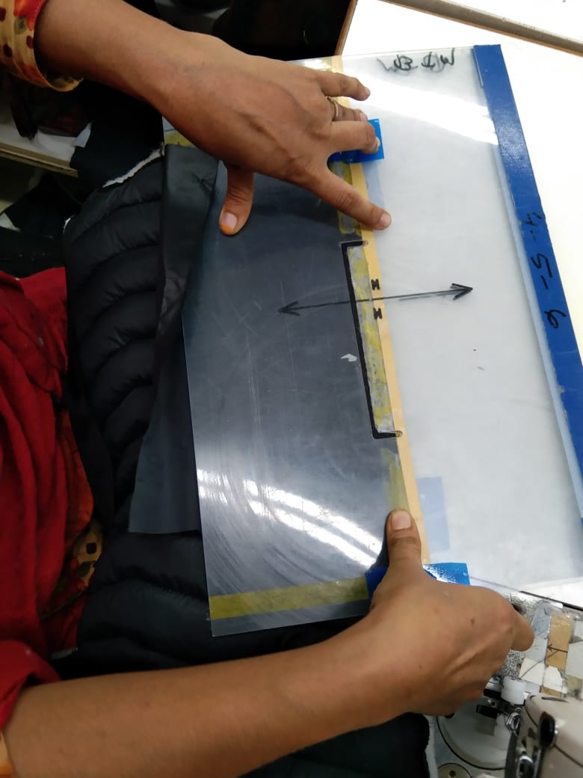
After

Slide 10
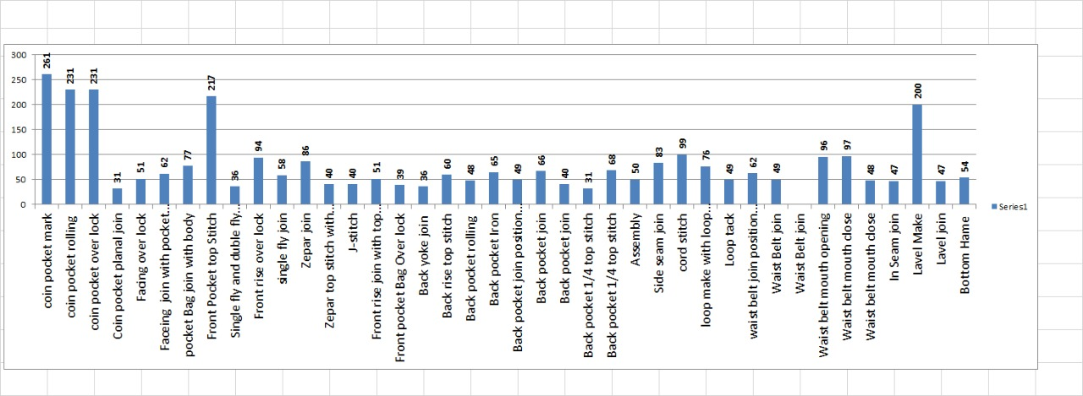
Result
Before

Slide 11
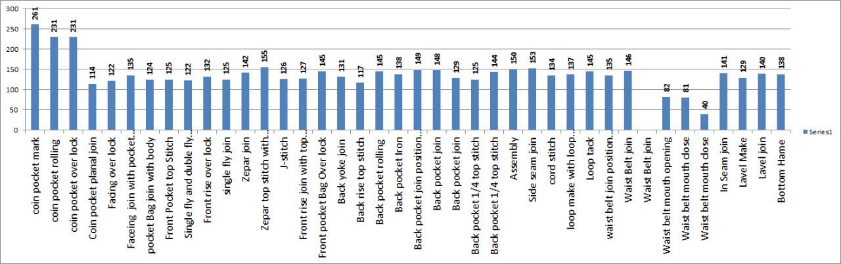
After

Slide 12
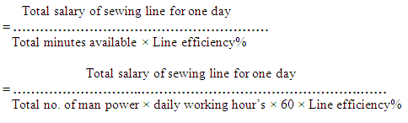
1. Cost per minute of sewing line,
10000
= = 0.85 Taka
39 x10x60x0.5
Before
After
10000
= 0.05 Taka
39 x10x60x0.5

Slide 13
Conclusion
Quality is the most important question for customer satisfaction. Not only in apparel manufacturing industries but also in any production; Good quality increases customer satisfaction through increasing the value of the product, it establishes brand or company name, and builds up a good relationship with the exporter, which in turn results into high volume sales and higher profit.

