Slide 1

Design and Construction of a Pneumatic Can Crusher Using Control System
Presented By:
Mehedi Hasan Emon
BME1902018152
Tonay Biswas
BME1902018222
Rony Khondoker
BME1902018131
Somor Shil
BME1902018134
Mohiuddin Al Tebeian
BME1902018228
Supervised By:
Md. Mainol Hasan
Assistant Professor
Department of
Mechanical Engineering
Sonargaon University (SU)
Department of Mechanical Engineering.
Sonargaon University (SU)

Slide 2
Abstract
Can crushing has been used by people for compression of cans after usage for a long time. Crushing cans by bare hands Is a difficult and very strenuous process. So here we propose a pneumatic based can crushing system that allows for fully automated can crushing. This is a very useful system for hotels/restaurants/public places where a large quantity of cans need to be disposed off. The can crusher can automatically hold cans in queue and crush them one at a time. The system uses pneumatic piston in a particular arrangement with supporting frame having vertical holders and can pushing system. The vertical roller based system is used to push cans through the arrangement. Once the cans reach the bottom a sensor detects this and pushes one can at a time through the roller into the crushing chamber. After a can is pushed the electronics system now operates the pneumatic piston. The piston now pushes the can to compress it against the bed mounted on the other side. This helps to achieve desired compression of can. Once this is done the piston pulls back and the system automatically and the compressed can is ejected by the mechanism from the bottom of the machine and next can is pulled in. This ensures efficient compression which helps in easy storage and disposal of cans.

Slide 3
Objectives
The objectives of this project are:
To design and implement Automatic Pneumatic Can Crusher System with Storage.
To Crush can automatically.
To develop of a recycle bin tin can crusher.
To fabricate recycle bin tin can crusher low cost and time consuming
To implement a system for easy to our daily life.
Take several test and test its accuracy.

Slide 4
Methodology
Creating an idea for Design and construction of an Automatic Pneumatic Can Crusher System with Storage.
And drawing and listed of components/materials to know which components/materials need to construct it.
Collecting the all components/materials for construct the system.
Finally, we constructed this system & checked it finally that working very well.

Slide 5
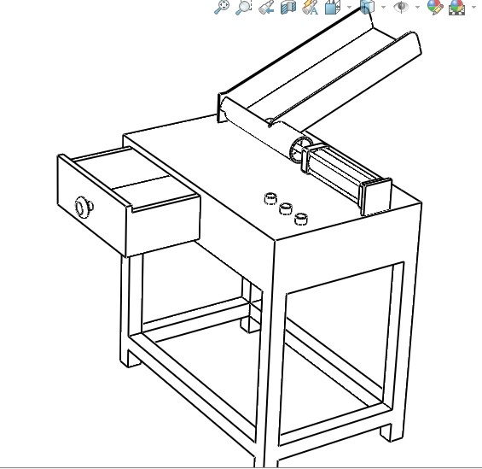
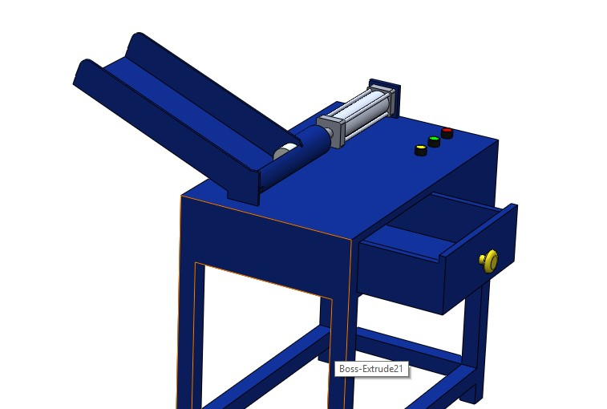
Working Drawing
Fig:1.1 Working Drawing of Project

Slide 6
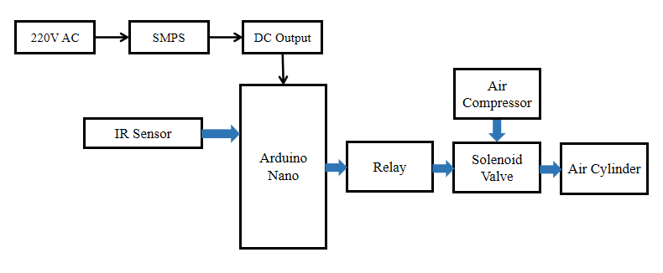
Block Diagram
Figure: Block diagram

Slide 7
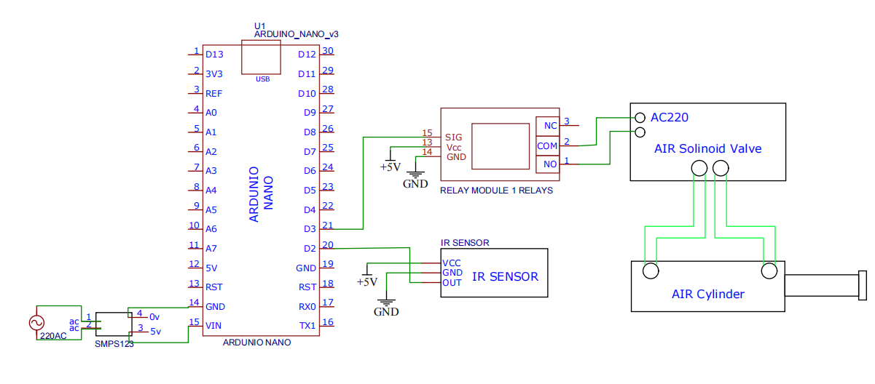
Circuit Diagram
Figure: Circuit diagram

Slide 8
Working Principle
The way our Automatic Pneumatic Can Crusher Using System with Storage that we take the 220V rms from the supply voltage and then give it to the SMPS, the SMPS has a step-down transformer inside that stepped that voltage down to 12V. This 12V supply is still alternating in nature so now, we use a Full Wave Bridge Rectifier to rectify that output. Now we use Capacitors to smooth the curve and turn the 12V pulsating current to pure 12V direct current. But this 12V dc is still much high for our project. So, we use a 7805 5V Regulator IC to make that voltage come down to 5V. This power is directly connected with the main circuit. Here we use Arduino Nano for control this unit, SMPS, IR Sensor, Relay, Air Compressor, Solenoid Valve, Air Cylinder etc. When a can give the case then IR sensor sense it then automatically . The pressure of the air from the air compressor passes the pneumonia pipe and through the air cylinder the crasher will rise and forcefully apply on an object which is crash a can. This is how our project works.

Slide 9
Required Components
Air Compressor
Solenoid Valve
Pneumatic Actuator
Pneumatic Pipe
SMPS
Arduino Nano

Slide 10

Arduino Nano
The Arduino Nano is open-source hardware.
The Arduino Nano is a small, complete, and breadboard-friendly board based on the ATmega328.
It lacks only a DC power jack, and works with a Mini-B USB cable instead of a standard one.
Fig: Arduino Nano

Slide 11

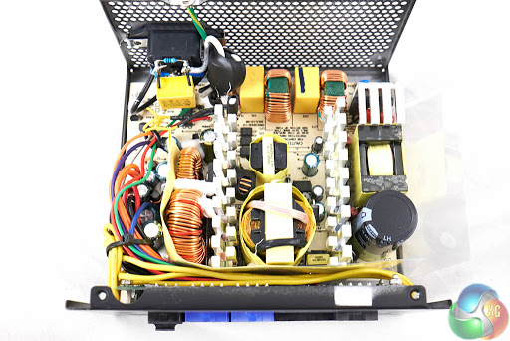
SMPS
A switched-mode power supply (switching-mode power supply, switch-mode power supply, switched power supply, SMPS, or switcher) is an electronic power supply that incorporates a switching regulator to convert electrical power efficiently. Like other power supplies, an SMPS transfers power from a DC or AC source (often mains power) to DC loads, such as a personal computer, while converting voltage and current characteristics. Unlike a linear power supply, the pass transistor of a switching-mode supply continually switches between low-dissipation, full-on and full-off states, and spends very little time in the high dissipation transitions, which minimizes wasted energy. A hypothetical ideal switched-mode power supply dissipates no power. Voltage regulation is achieved by varying the ratio of on-to-off time (also known as duty cycles).
Fig : SMPS

Slide 12
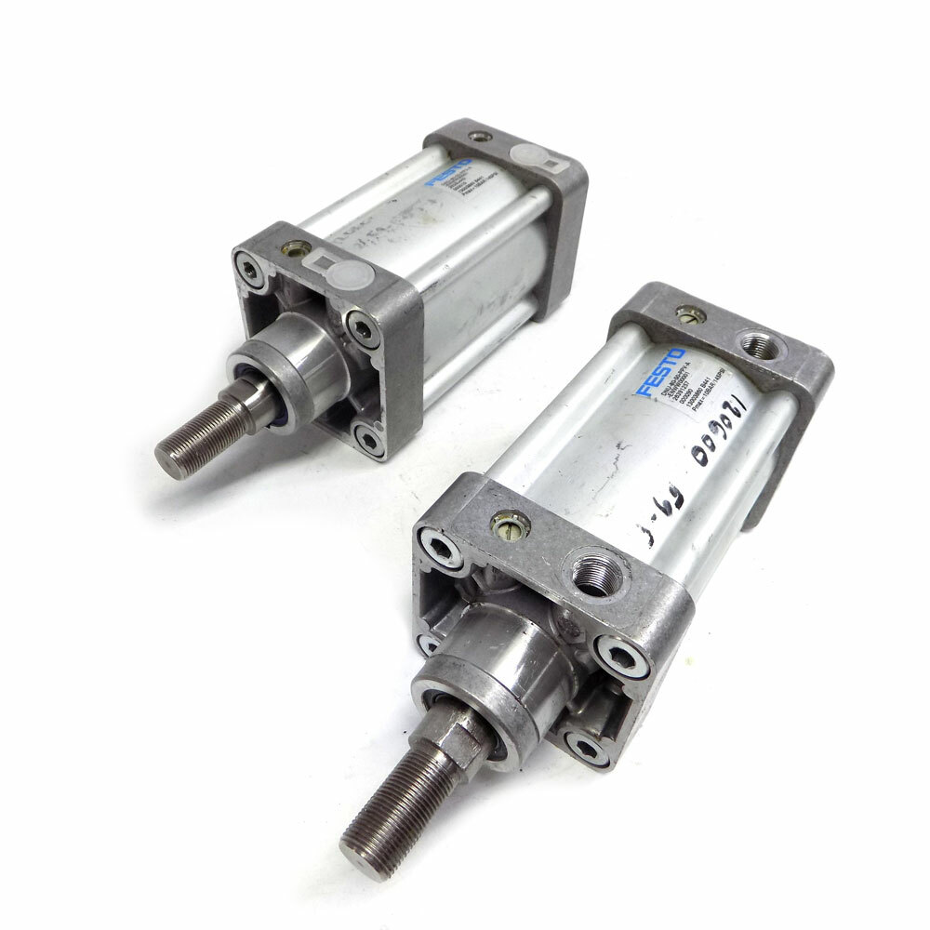
Pneumatic Actuator
Pneumatic actuators enable considerable forces to be produced from relatively small pressure changes. Pneumatic energy is desirable for main engine controls because it can quickly respond in starting and stopping as the power source does not need to be stored in reserve for operation. Moreover, pneumatic actuators are cheaper, and often more powerful than other actuators. These forces are often used with valves to move diaphragms to affect the flow of air through the valve.
Specifications:
Manufacturer: Festo
Model: DNU-80-50-PPV-A
  Type of Operation: Double Acting
  Piston Diameter: 80mm
  Stroke: 50mm
  Pneumatic Connection: G3/8
  Operating Pressure Range (Bar) 0-12
Figure : Pneumatic Actuator

Slide 13
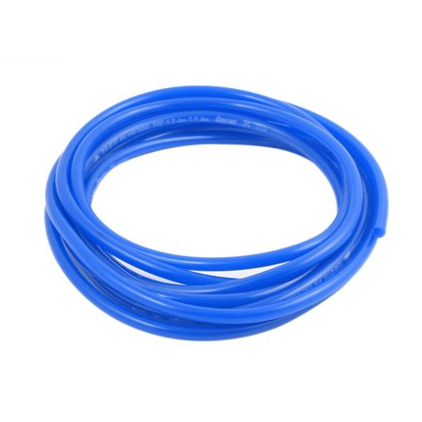
Pneumatic Pipe
THE basic function of pneumatic tubing and hose is to convey pressurized air to actuators, valves, tools and other devices. ... Tubing for air applications may be extruded of a single material or reinforced internally, typically with textile fibers, for higher strength.
Figure : Pneumatic Pipe

Slide 14
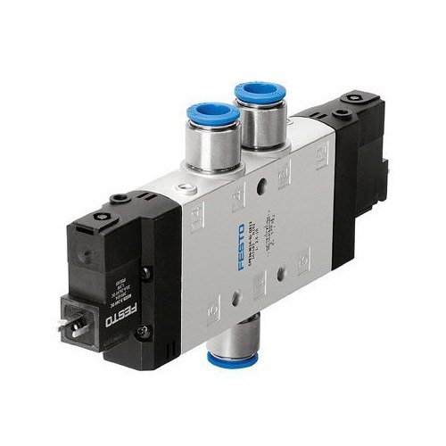
Solenoid Valve
A solenoid valve, also known as an electrically-operated valve, is a valve that uses electromagnetic force to operate. When an electrical current is passed through the solenoid coil, a magnetic field is generated which causes a ferrous metal rod to move. Solenoid valves are controlled by the action of the solenoid and typically control the flow of water or air as a switch.
Product Specification
Port Size | 1/8" 1/4" 3/8" 1/2" M5
Material | Aluminum Alloy
Brand | Festo
Response Time | 0.05Second
Protection Class | IP65
Voltage Range | -10%~+10%
Figure : Solenoid Valve

Slide 15
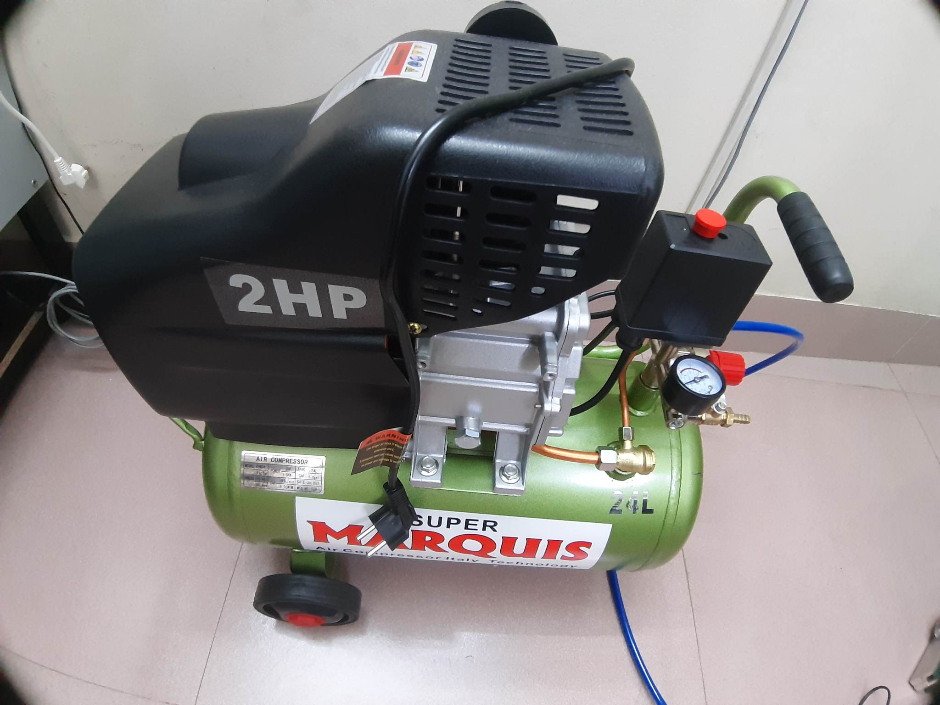
Air Compressor
An air compressor is a pneumatic device that converts power (using an electric motor, diesel or gasoline engine, etc.) into potential energy stored in pressurized air (i.e., compressed air). By one of several methods, an air compressor forces more and more air into a storage tank, increasing the pressure. When the tank's pressure reaches its engineered upper limit, the air compressor shuts off. The compressed air, then, is held in the tank until called into use. The energy contained in the compressed air can be used for a variety of applications, utilizing the kinetic energy of the air as it is released and the tank depressurizes.
Figure : Air Compressor

Slide 16
Advantages
Easy operation since pneumatic is used for providing effort for crushing
Good accuracy to destroy object.
Time saving machine for industrial work.
Reduce energy waste.
No Oil consumption.
Less skill technicians is sufficient to operate.
Installation is simplified very much.
Less time and more profit.
Simple construction
Reduced weight of the system.
Ease of operation.

Slide 17
Applications
The project has a major application in the
The project has a major application in the
It is used in Recycling process and recycling industries
It is used for easy transportation of cool drinks cans by crushing and compressing its volume
Aluminium can recycling is easier
Plastics bottles, Nylon bottles can also be crushed for industries to reduce the volume of wastages by crushing

Slide 18
Discussion
After the successful fabrication of the Can Crusher, the machine was tested from which we obtained the above-mentioned observations. The cans were crushed up to the desired volume in the manually operated Crusher. Further we have seen that the Cans were crushed to a much smaller volume in the electrically operated one. The crushers have been fabricated keeping in mind about the minimum power requirement and minimum effort to the operator. We faced many problems in the whole work. Ignoring everything, we have achieved our desired results. We can use in many other places besides our home. Hopefully it will play a big role in modernizing our industry.

Slide 19
Future Scope
The model can be improved by making some changes in the program and components. Some suggestions are given below-
• We can add a pressure meter and pressure controller .
• We will increase its working accuracy level.
• We will add an air reserve tank.

Slide 20
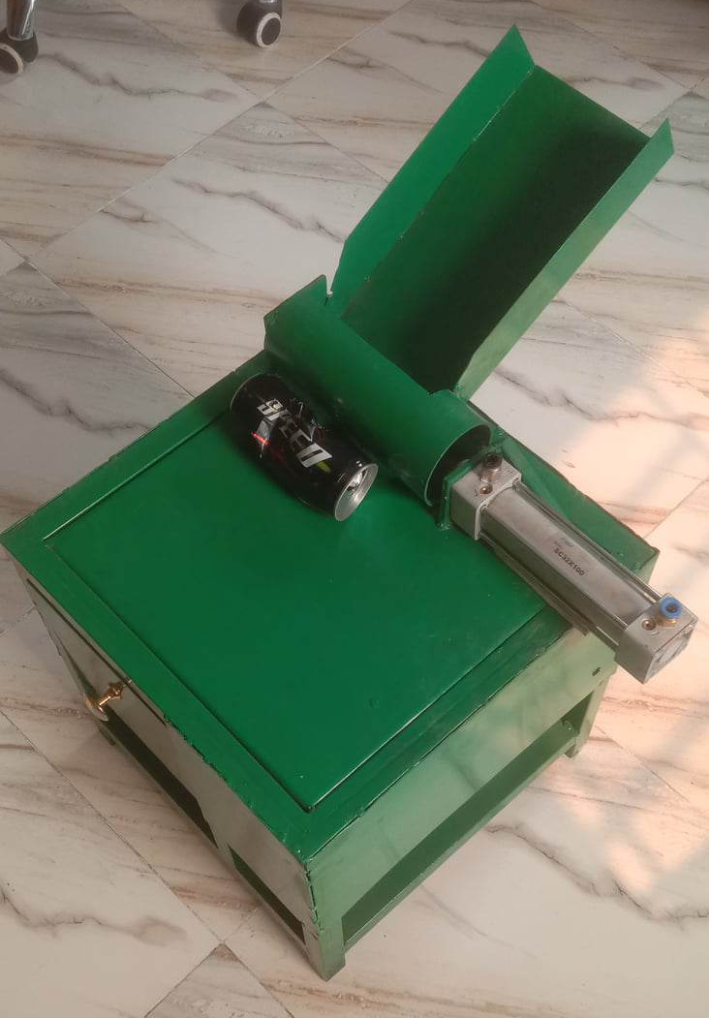
Image of the Project

Slide 21
Conclusion
The above design procedure is been adopted for the fabrication of fully automatic can crusher machine which will make the product durable for the long time as well as make it efficient and also helps to understand the concept of design. Thus with the help of this design we can fabricate an automatic can crusher machine to simply reduce the volume of cans as well as to reduce the human fatigue. Also the automatic operation can be possible using the mechanical power transmission operated by electric motor or electric actuator etc. This solely will reduce the volume of the cans or bottles to reduce the transportation cost by reducing its volume.

Slide 22
Thank You

